Slide 1
Transformers
Attention is All You Need
Ashish Vaswani et. al., NeurIPS 2017
https://papers.nips.cc/paper/2017/file/3f5ee243547dee91fbd053c1c4a845aa-Paper.pdf

Slide 2
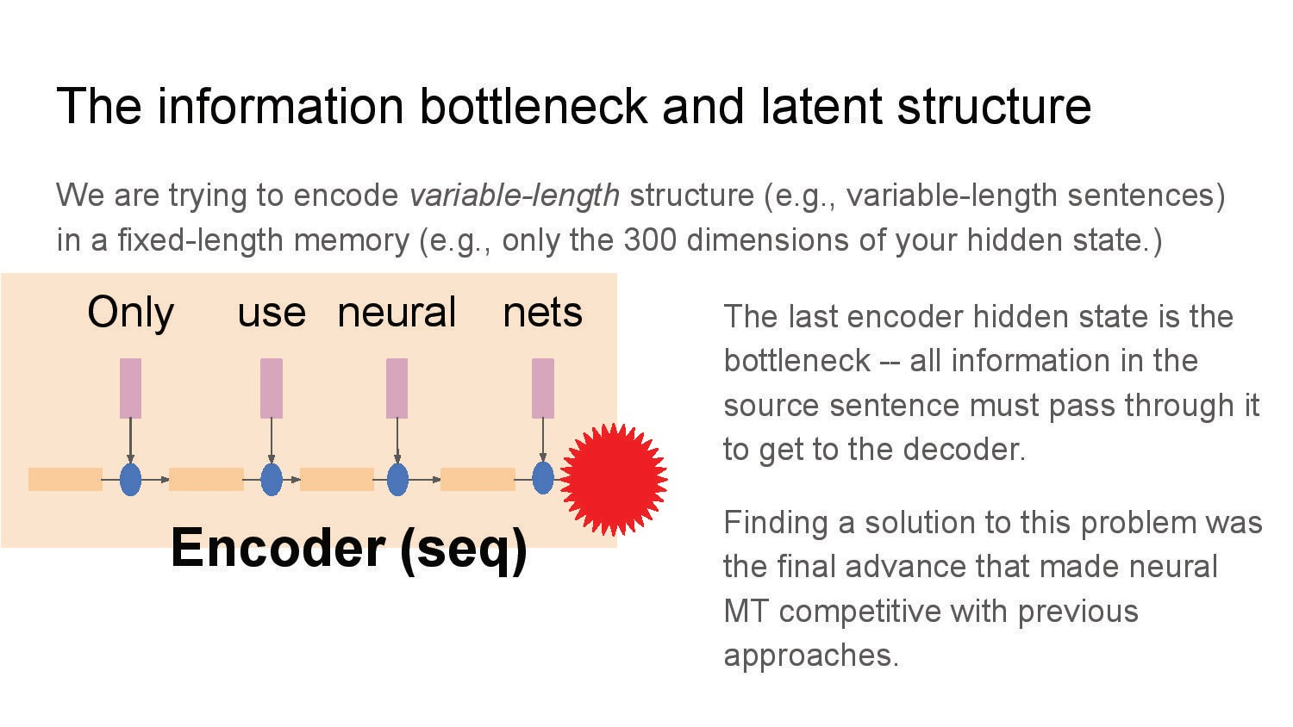

Slide 3
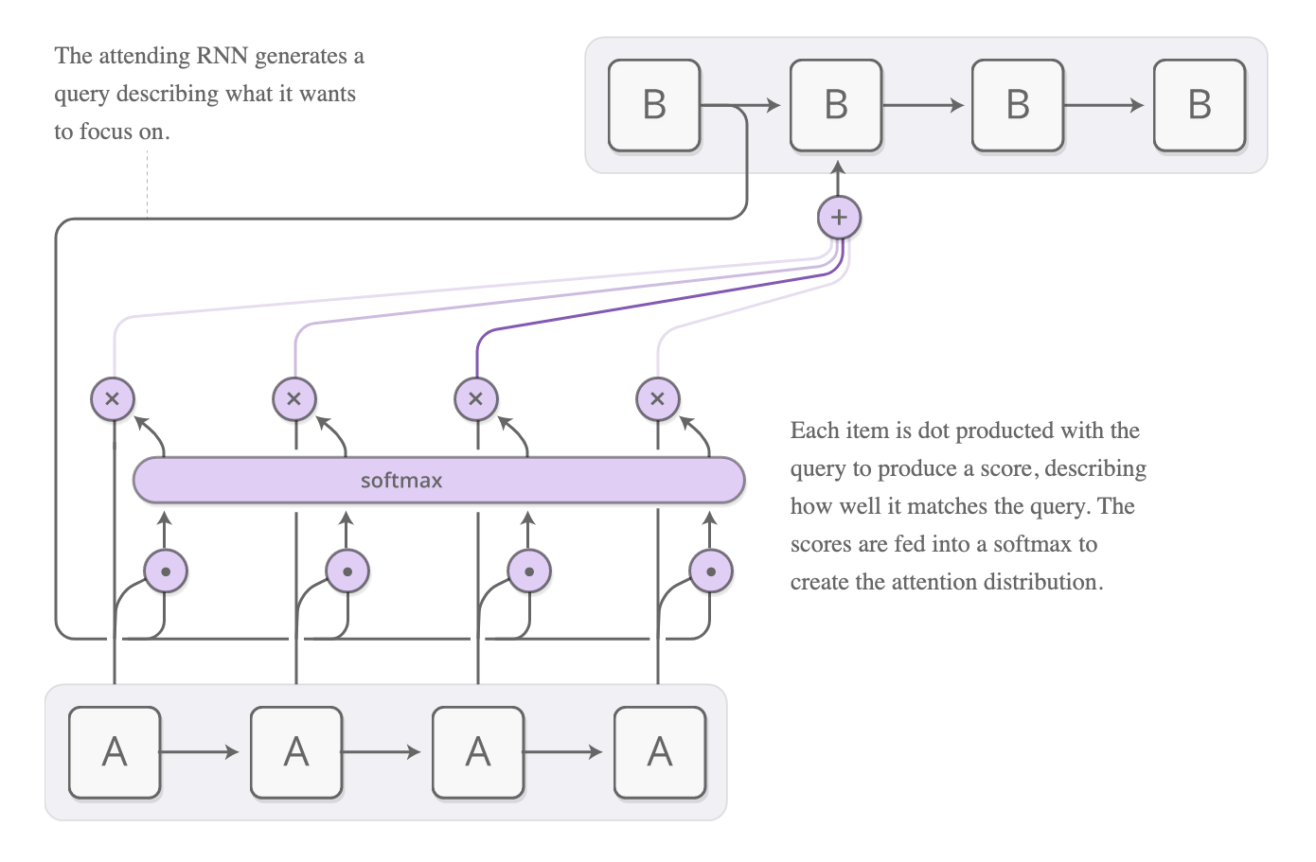
Attentional Interfaces
When translating, pay attention to the word currently translated
Attention == focusing on part of a subset of the given information

Slide 4
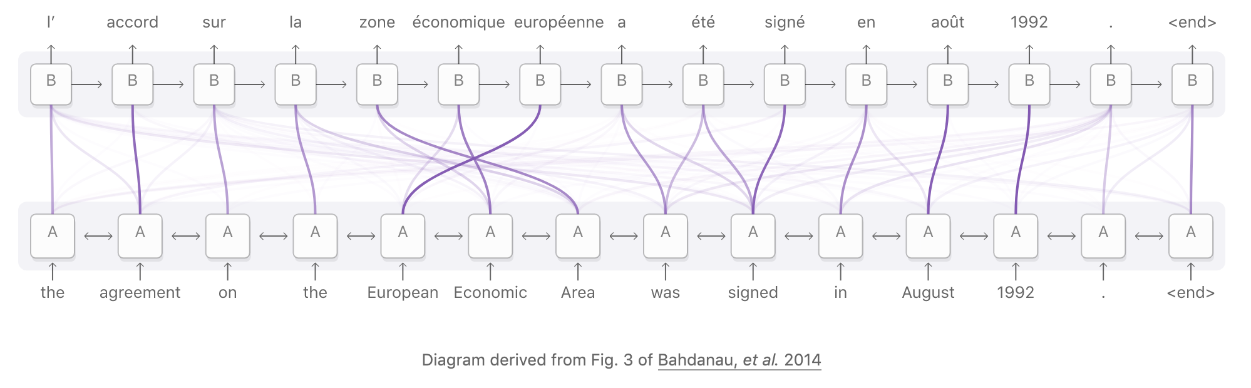
Attentional Interfaces
One use of attention is translation
Traditional seq2seq model boils entire input into a single vector and then expands it back out
Attention allows RNN processing the input to pass along information about each word it sees. The RNN generating the output focuses on words as they become relevant

Slide 5
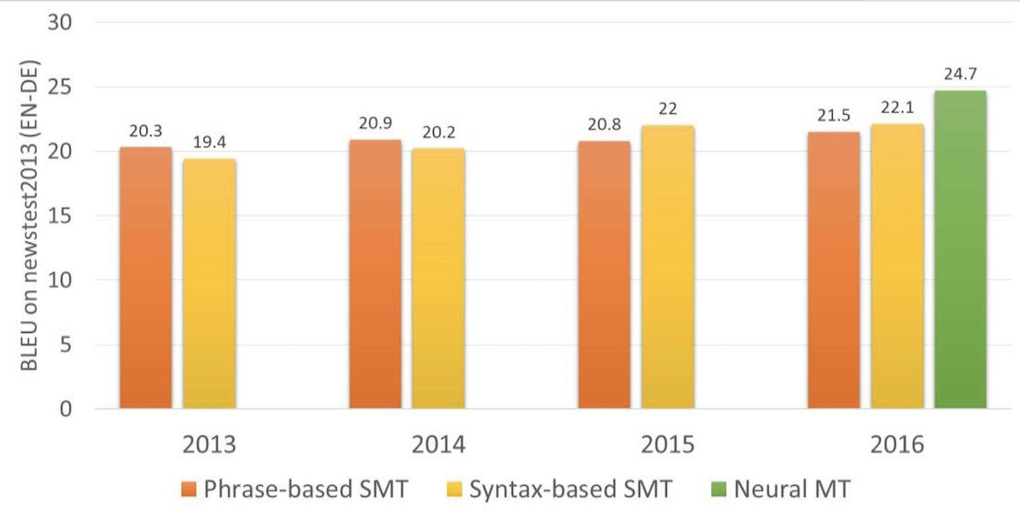
Neural Machine Translation (NMT)
In two years, neural networks surpassed everything that had appeared in the past 20 years of translation. Neural translation contains 50% fewer word order mistakes, 17% fewer lexical mistakes, and 19% fewer grammar mistakes. The neural networks even learned to harmonize gender and case in different languages. And no one taught them to do so.
Figure from "A history of machine translation from the Cold War to deep learning" by Ilya Pestov

Slide 6
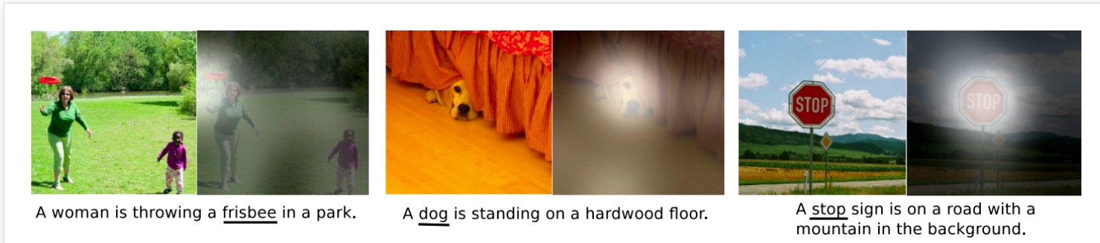
Attentional Interfaces
Is also used in image captioning
On the interface between a CNN and an RNN
RNN will look at different position of an image as it generates each word
Attention can be used whenever you want to interface with a NN that has a repeating structure in its output

Slide 7
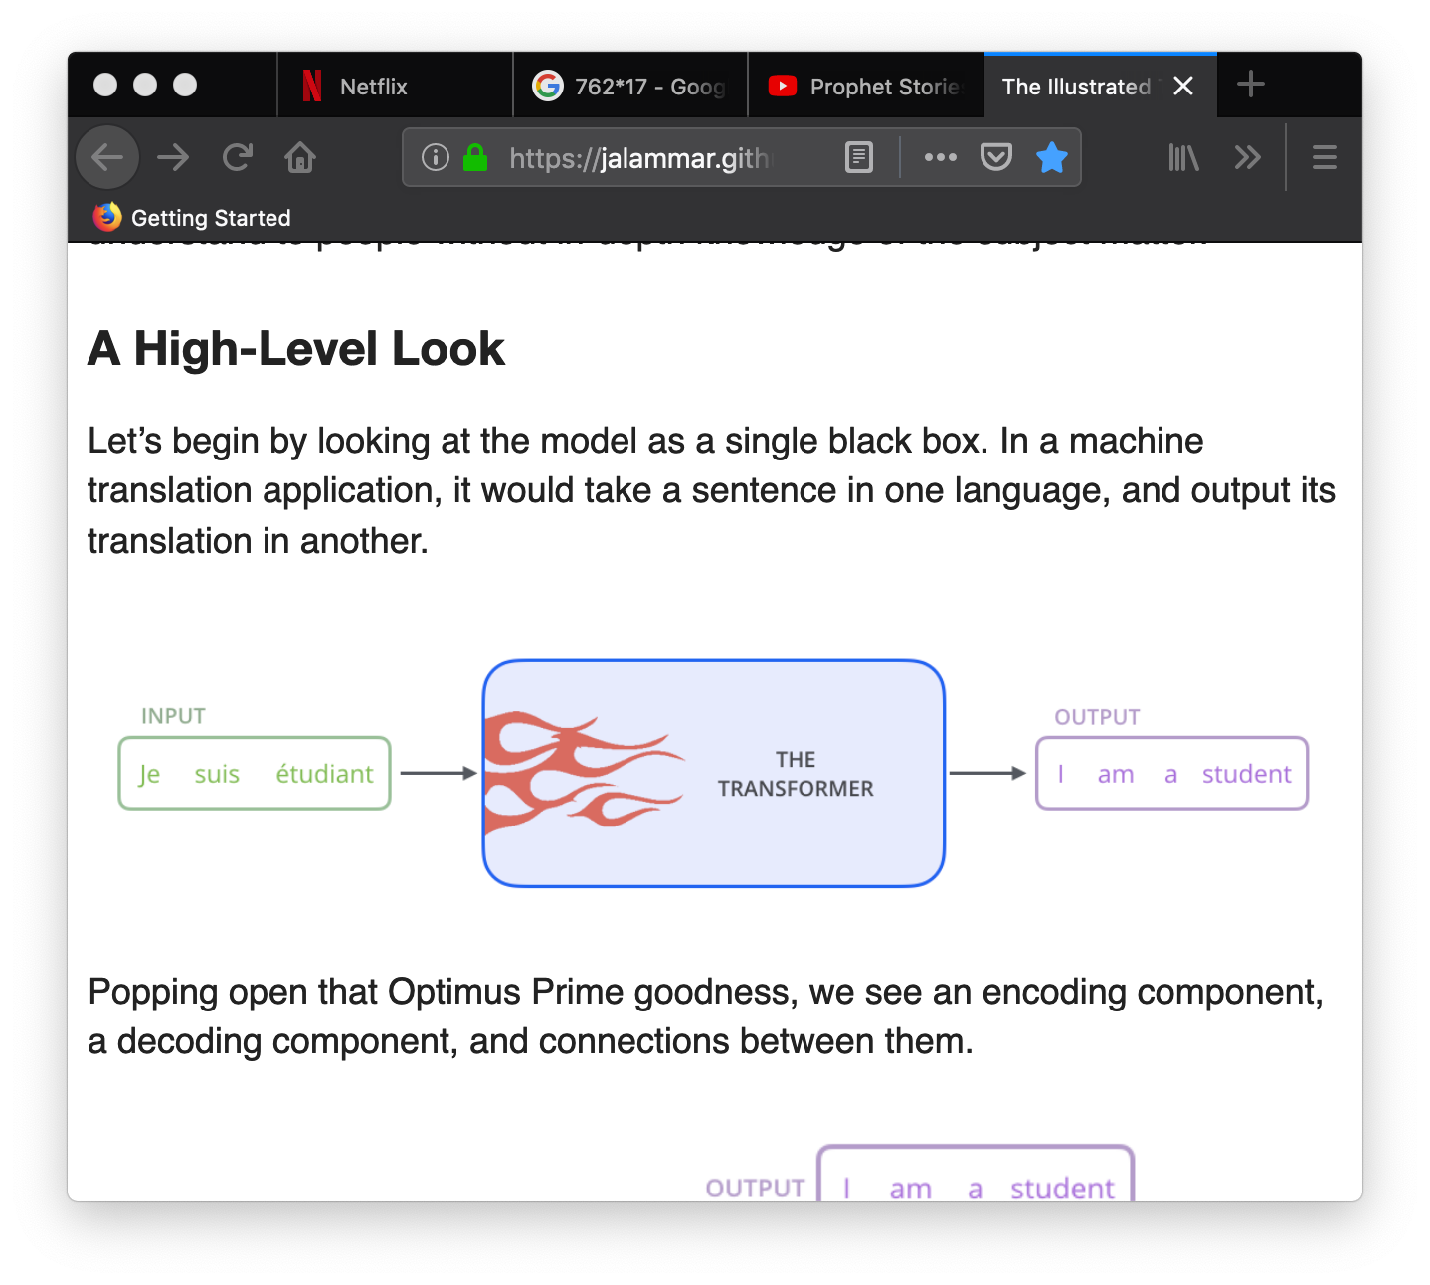
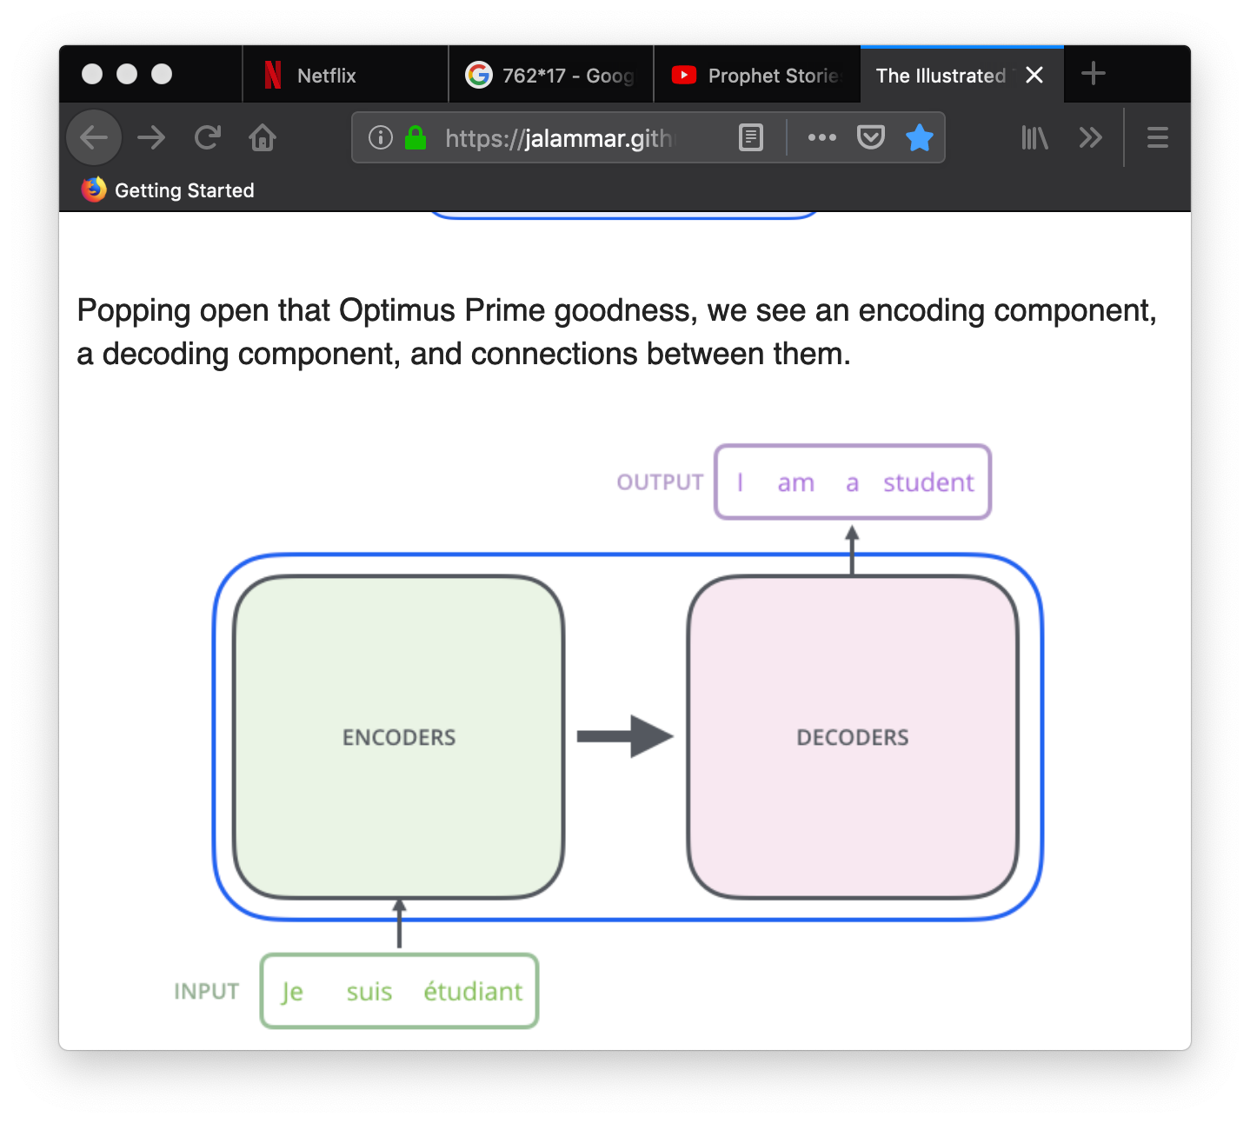
Attention is all You Need
https://jalammar.github.io/illustrated-transformer/
Improve NMT

Slide 8
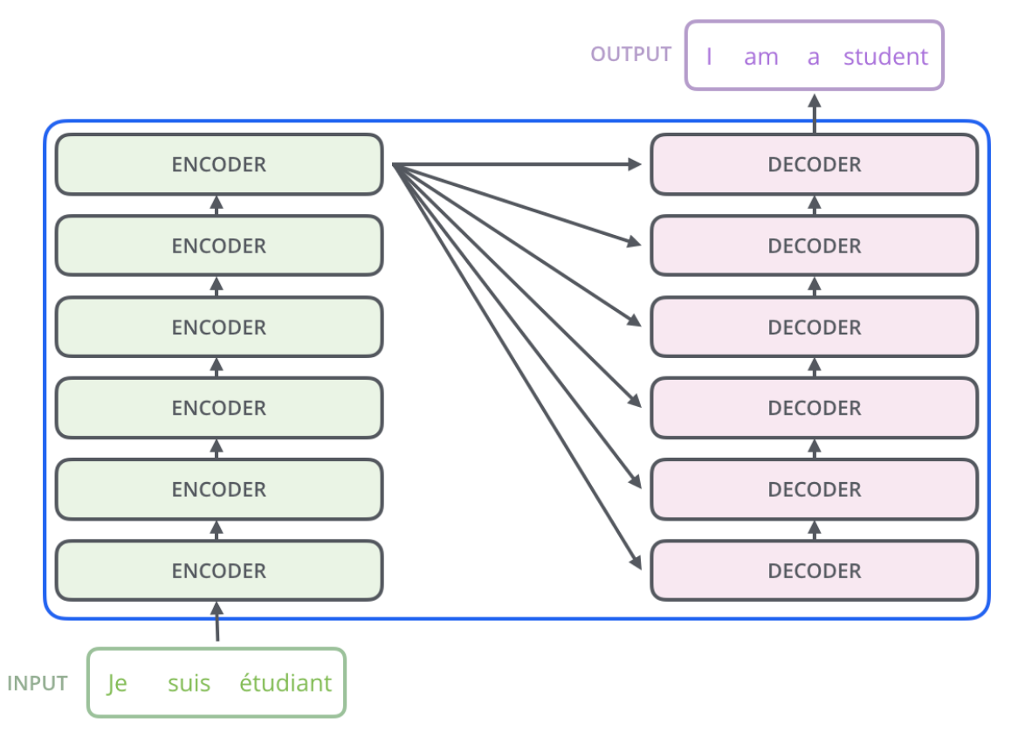
Attention is all You Need
Transformer
Stack of Encoders
Stack of Decoders

Slide 9
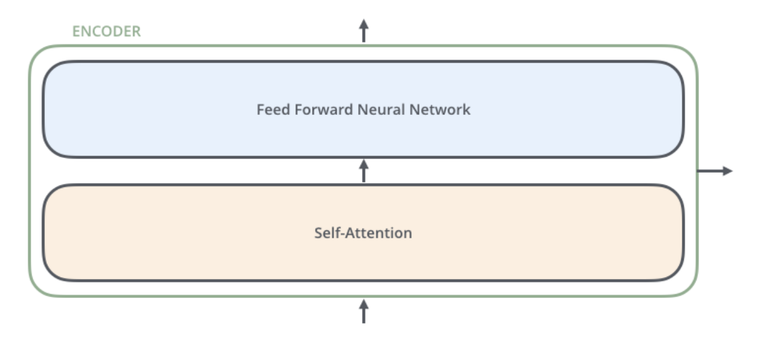
Attention is all You Need
Each encoder:
Self-attention: look at other words in the input as it encodes a specific word
FFNN is independently applied to each position

Slide 10
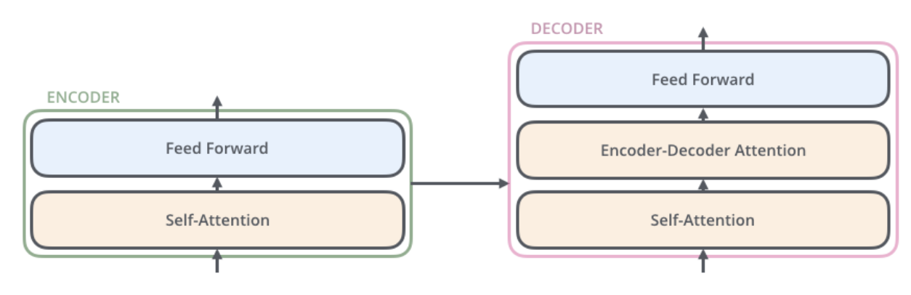
Attention is all You Need
Each decoder:
Has attention layer that lets it focus on relevant parts of the input sentence

Slide 11
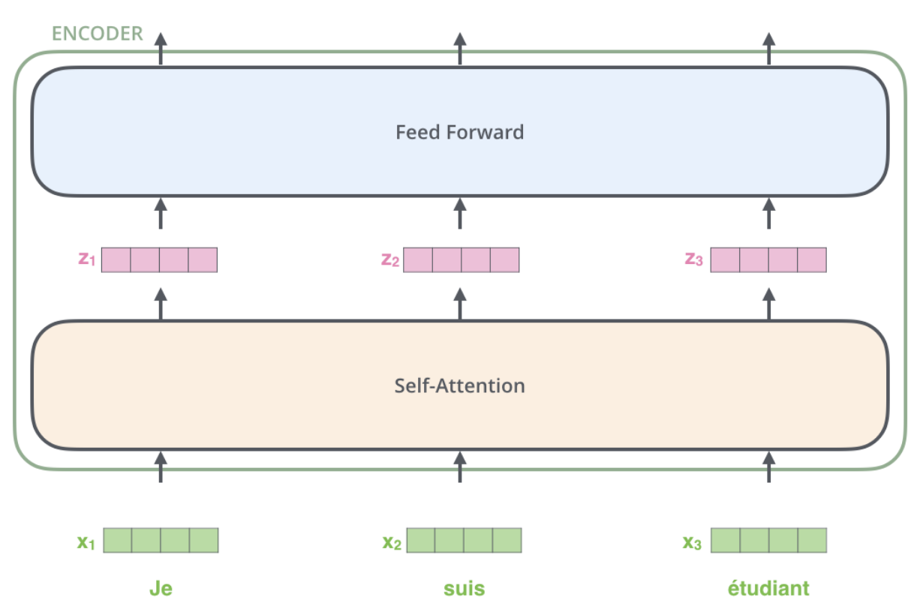
Attention is all You Need
Input:
The encoder receives a list of vectors as input

Slide 12
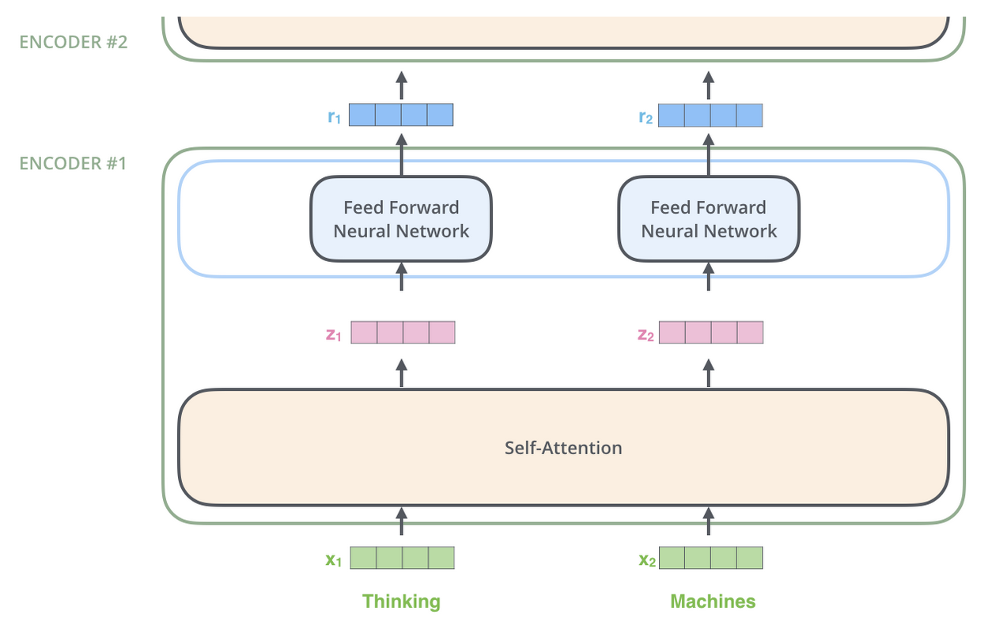
Attention is all You Need
Input:
The encoder receives a list of vectors as input
Word in each position flows through its own path in the encoder

Slide 13
Attention is all You Need
Self attention: allows to associate “it” with “animal” by allowing the model to look at other positions in the input sentence for clues that can help lead to a better encoding of the word “it”
“The animal didn't cross the street because it was too tired”

Slide 14
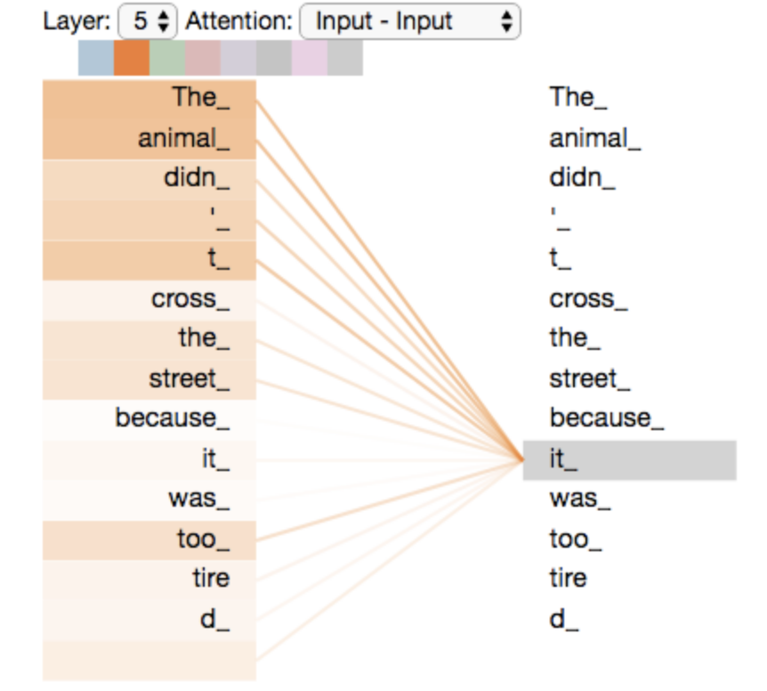
Attention is all You Need
Self attention:
“The animal didn't cross the street because it was too tired”

Slide 15
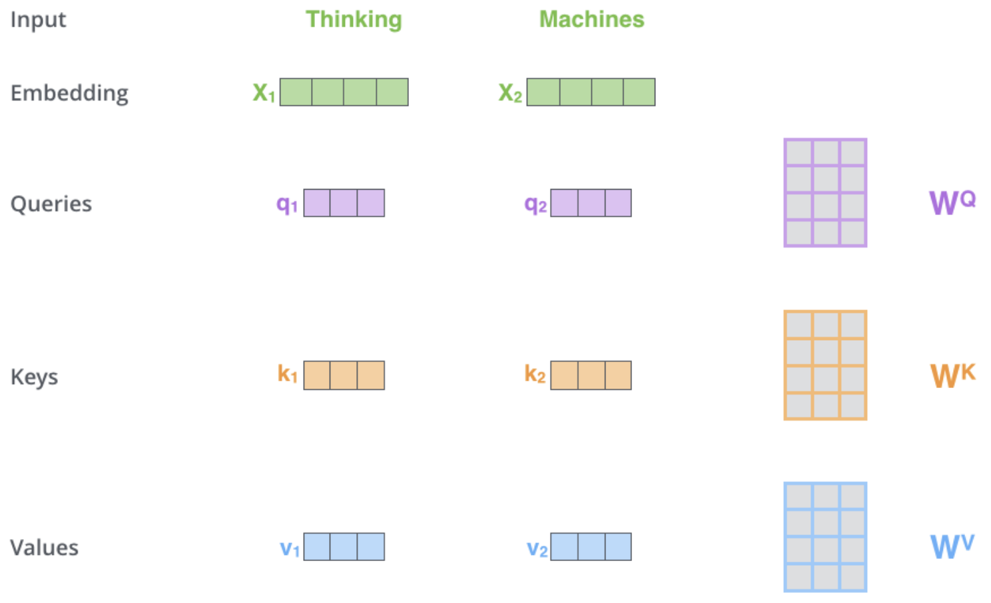
Attention is all You Need
Calculating self attention:
Create three vectors from each of the encoder’s input vectors:
Query key
Key vector
Value vector

Slide 16
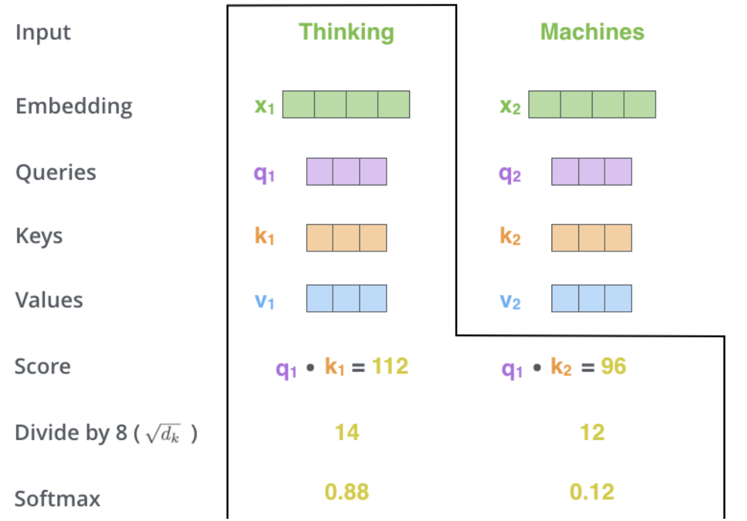
Attention is all You Need
Calculating self attention:
Create three vectors from each of the encoder’s input vectors:
Use the vectors to compute the attention score
Score each word of the input sentence against the word we’re computing attention for
The score determines how much focus to place on other parts of the input sentence as we encode a word at a certain position

Slide 17
Attention is all You Need
Calculating self attention:
Create three vectors from each of the encoder’s input vectors
Use the vectors to compute the attention score
Notes:
Divide by sqrt(64) to make stable gradients → avoid the doc product result from becoming too large, and softmax too large result in pushing softmax to the two extremes where the change in gradient is too small

Slide 18
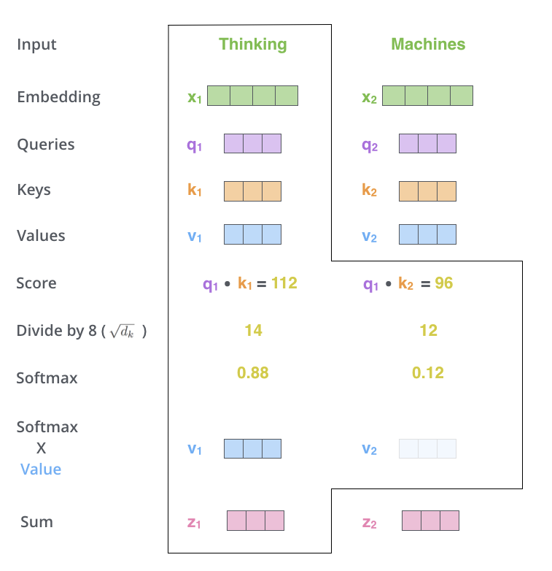
Attention is all You Need
Calculating self attention:
Create three vectors from each of the encoder’s input vectors
Use the vectors to compute the attention score
Multiply each value vector by the softmax score and sum up the weighted value vectors to produce output of the self attention layer for this word
Notes:
The intuition is to keep intact the values of the word(s) we want to focus on, and drown out irrelevant words by multiplying them with the attention scores

Slide 19
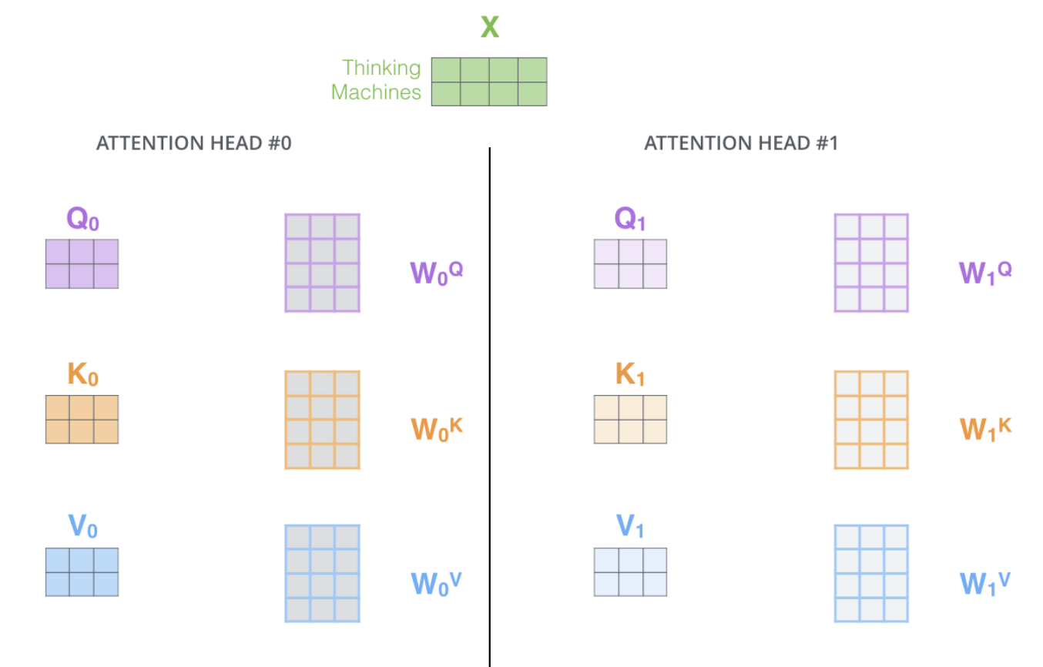
Attention is all You Need
There are several attention heads on each layer
Gives the attention layer multiple ”representation subspaces”
Notes:
The intuition is to keep intact the values of the word(s) we want to focus on, and drown out irrelevant words by multiplying them with the attention scores

Slide 20
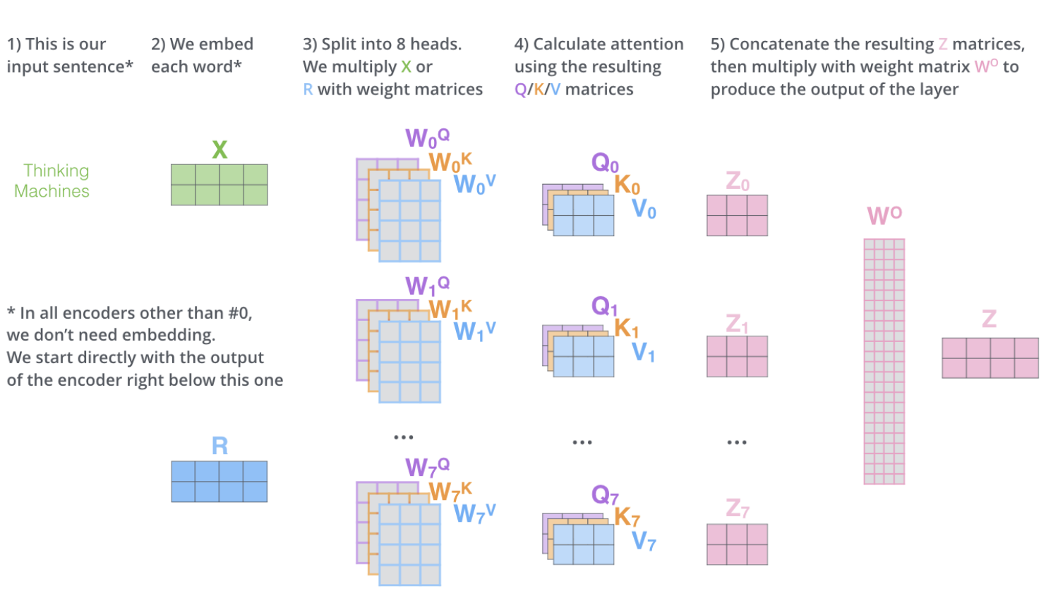
Attention is all You Need
Encoder summary
Notes:
The intuition is to keep intact the values of the word(s) we want to focus on, and drown out irrelevant words by multiplying them with the attention scores

Slide 21
Attention is all You Need
Positional encoding:
To account for the order of the words in the input sequence
Add a vector to each input embedding, the vector follows a specific pattern that helps the model determine the position of each word/distance between words in the sequence

Slide 22
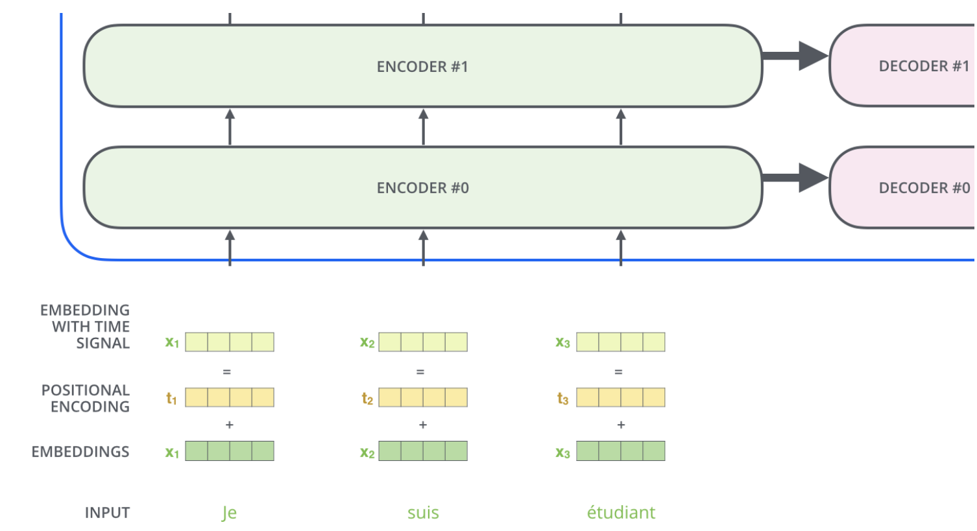
Attention is all You Need
Positional encoding:

Slide 23
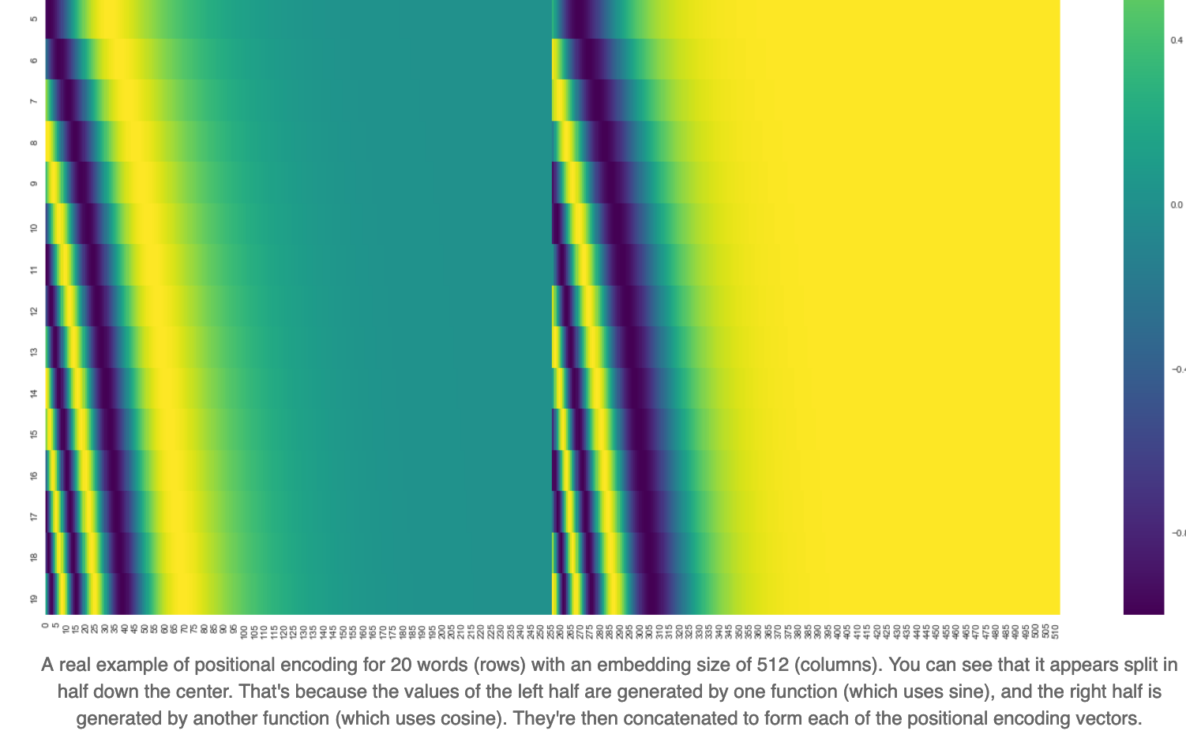
Attention is all You Need
Positional encoding:

Slide 24
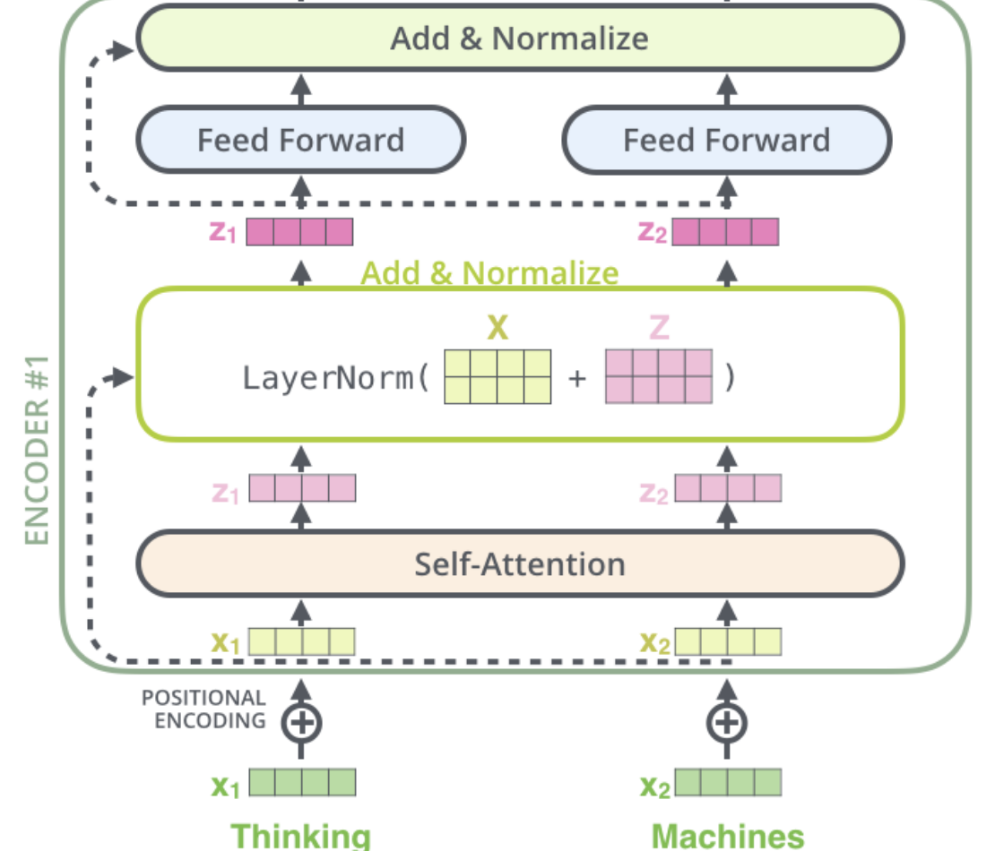
Residuals
Each encoder has a residual connection followed by a layer-normalization step

Slide 25
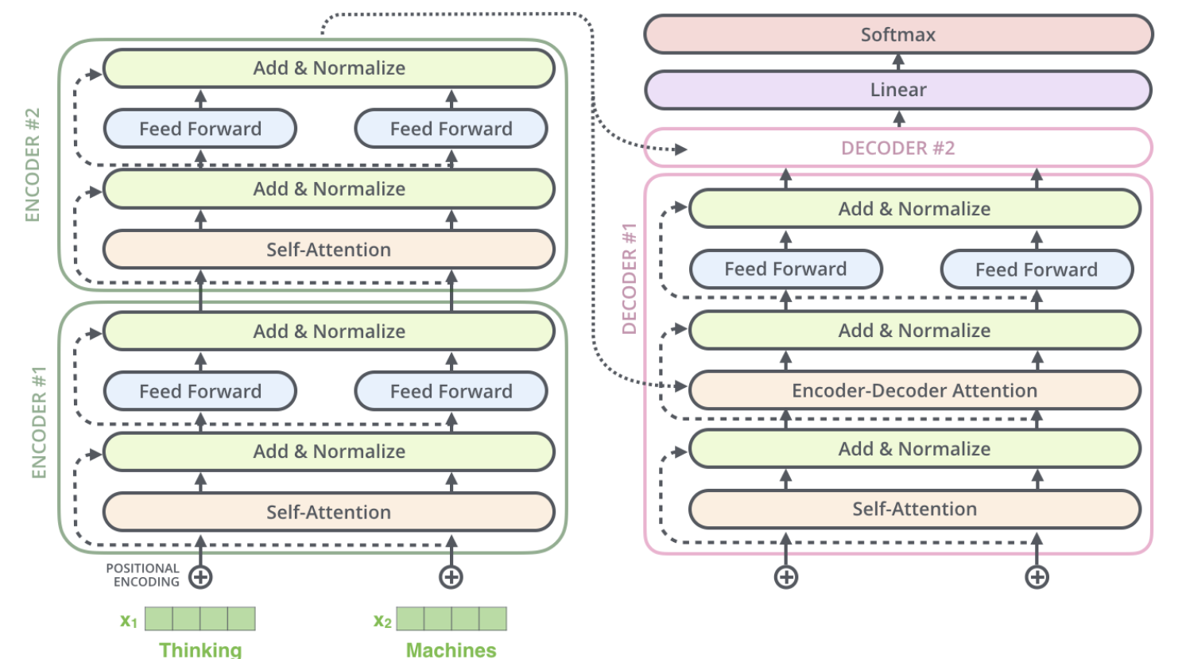
Residuals
Goes for decoders as well

Slide 26

Encoder-Decoder

Slide 27
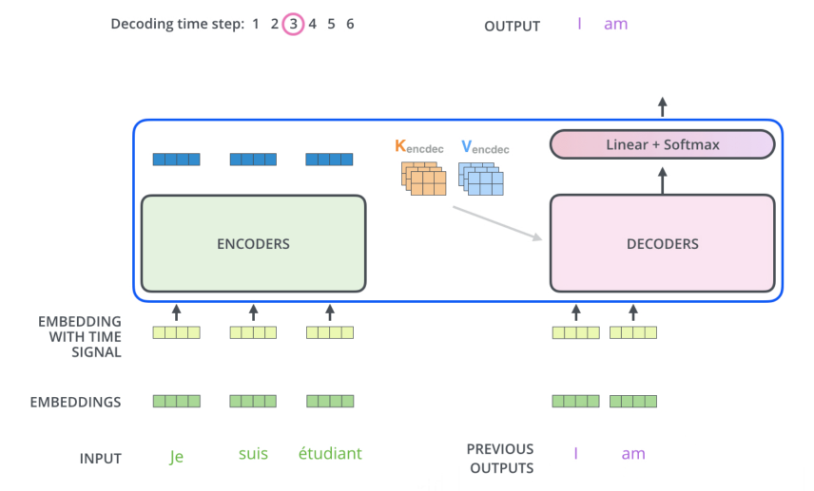
Encoder-Decoder
The process repeats
Output of each step is fed to the bottom decoder in the next time step
Self-attention layer only attends to earlier positions in the input
Encoder-Decoder attention creates only Queries matrix from the layer below

Slide 28
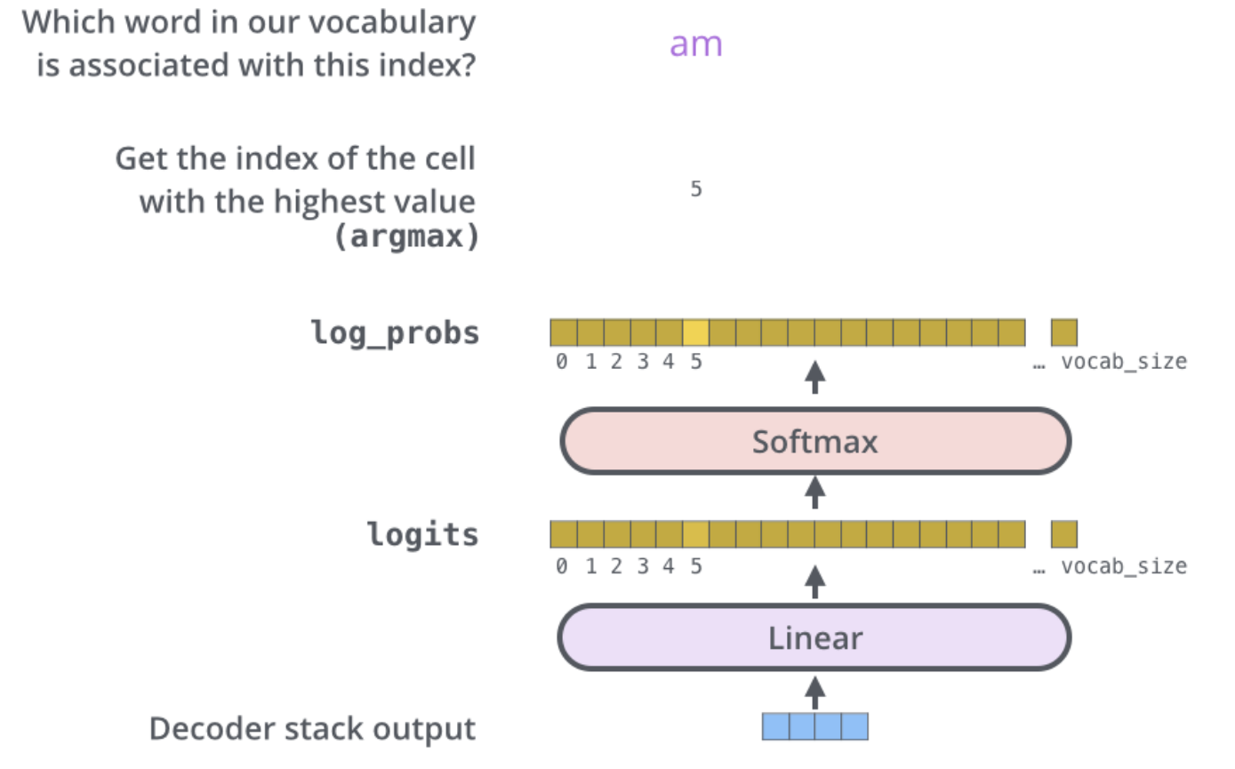
Final Decoder Layer
Output layer is turned into an output word
Probablity distribution over words

Slide 29
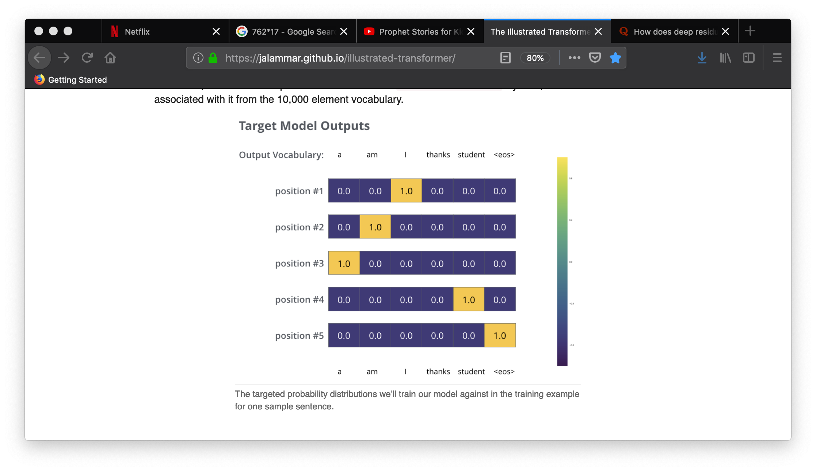
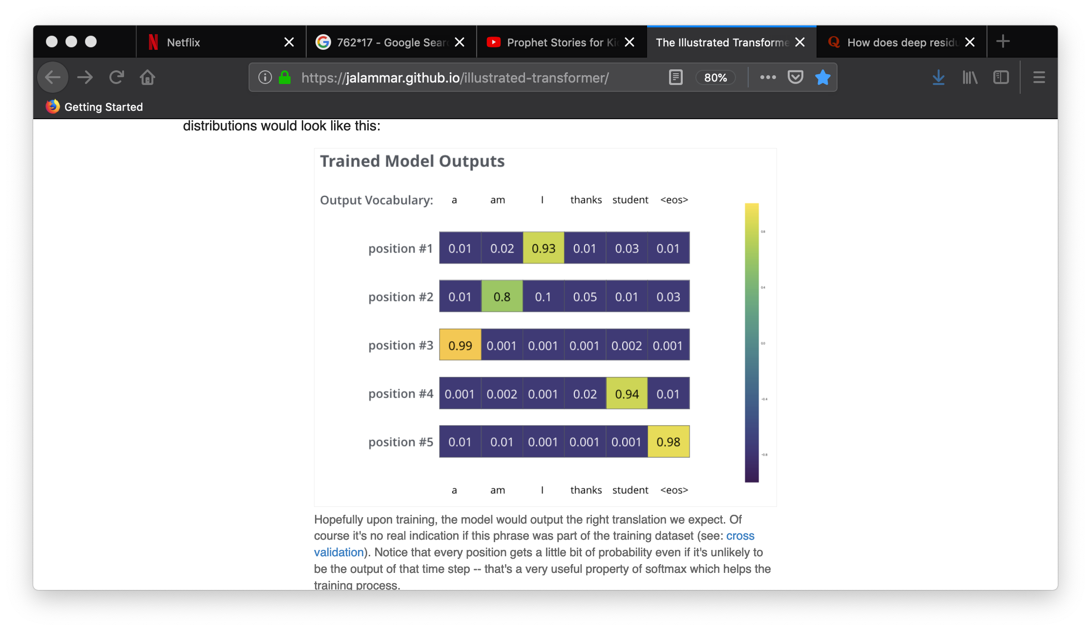
Final Decoder Layer
Output layer is turned into an output word
Compare probability distribution over words
Notes:
Cross-entropy or KL divergence to compare probability distributions for the loss function

Slide 30
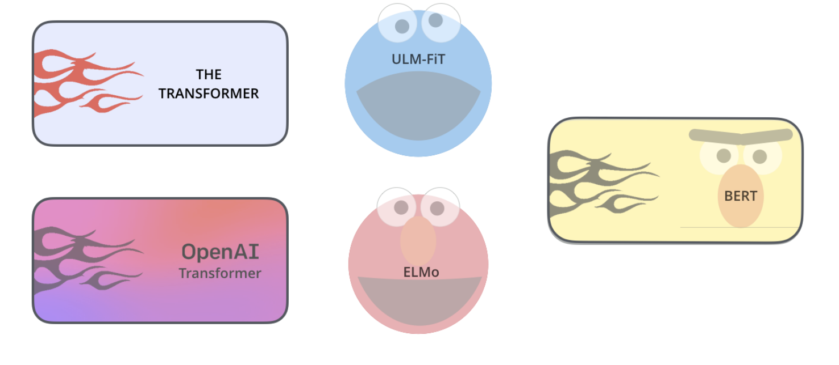
Word and Sentence Representations
http://jalammar.github.io/illustrated-bert/

Slide 31
Milestone
BERT: Bidirectional Encoder Representations from Transformers
A new method for pre-training language representations
Achieve state-of-the-art results on a wide array of NLP tasks
https://github.com/google-research/bert
Enables anyone to use this pre-trained LM and fine tune the representations for their tasks, without needing to train LM model from scratch

Slide 32
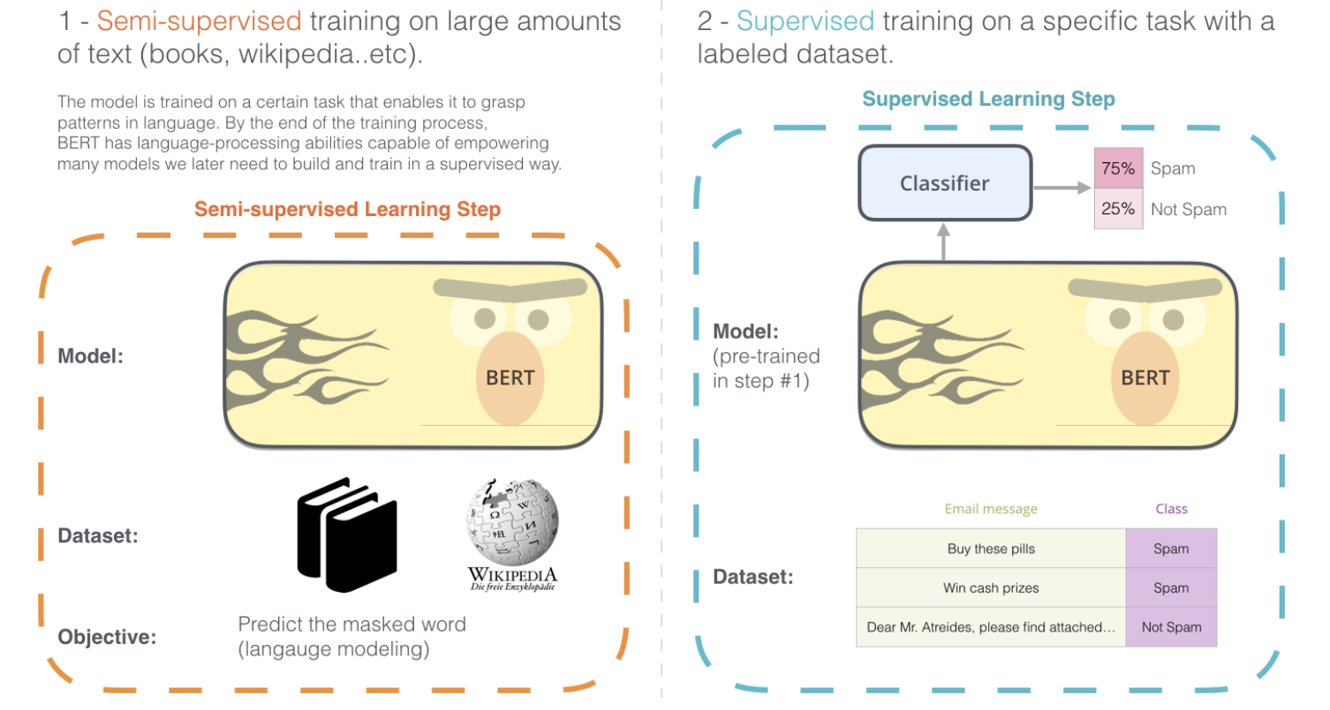
BERT

Slide 33
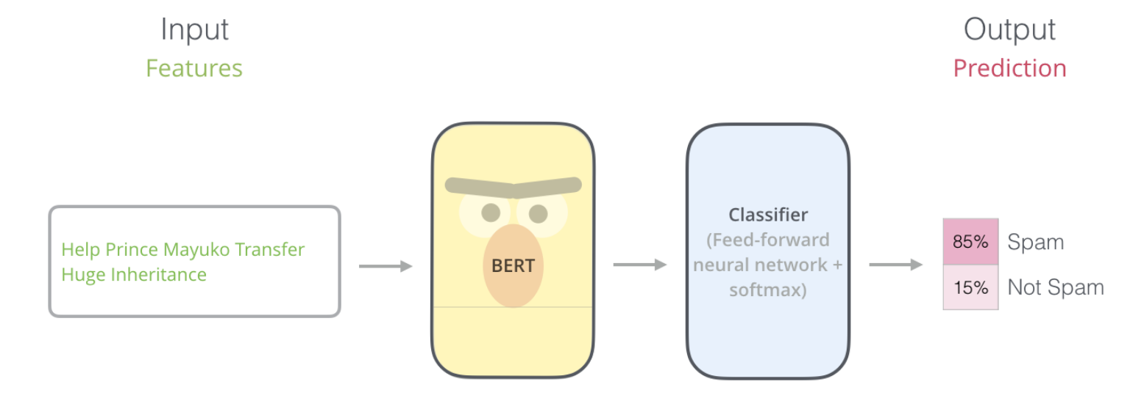
BERT
Example: sentence classification

Slide 34
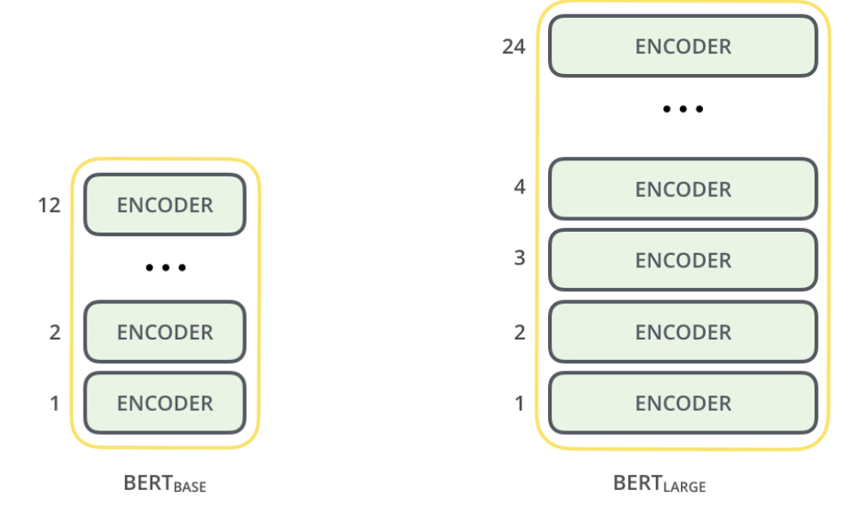
BERT
Basically, a trained Transformed Encoder stack
12/24 layers
12/16 attention heads per layer
768/1024 hidden units in FFNN
Initial transformer has:
6 layers
8 attention heads
512 hidden units

Slide 35
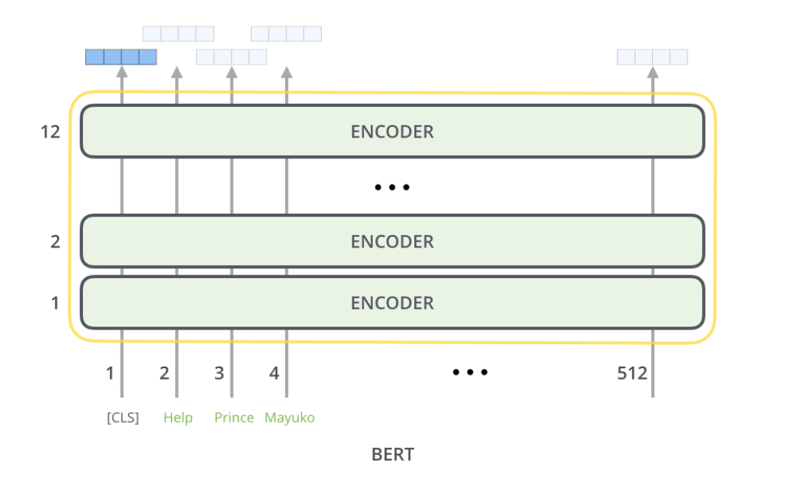
BERT
Each position outputs a vector of size hidden_size (768/1024)

Slide 36
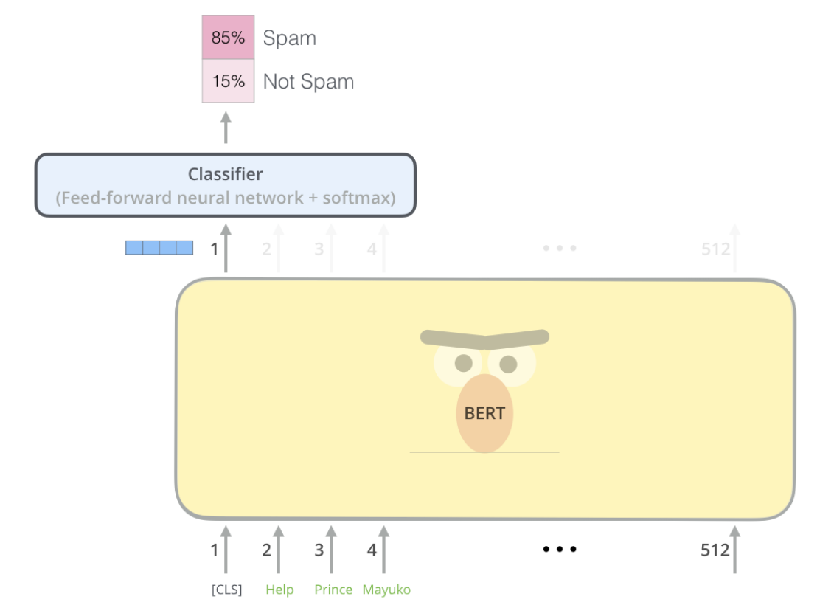
BERT
The output vector can then be used as the input for a classifier of our choosing

Slide 37
Context Encoding
Word2vec, Glove don’t really take context into consideration
The word “bank” has the same embedding no-matter what the context

Slide 38
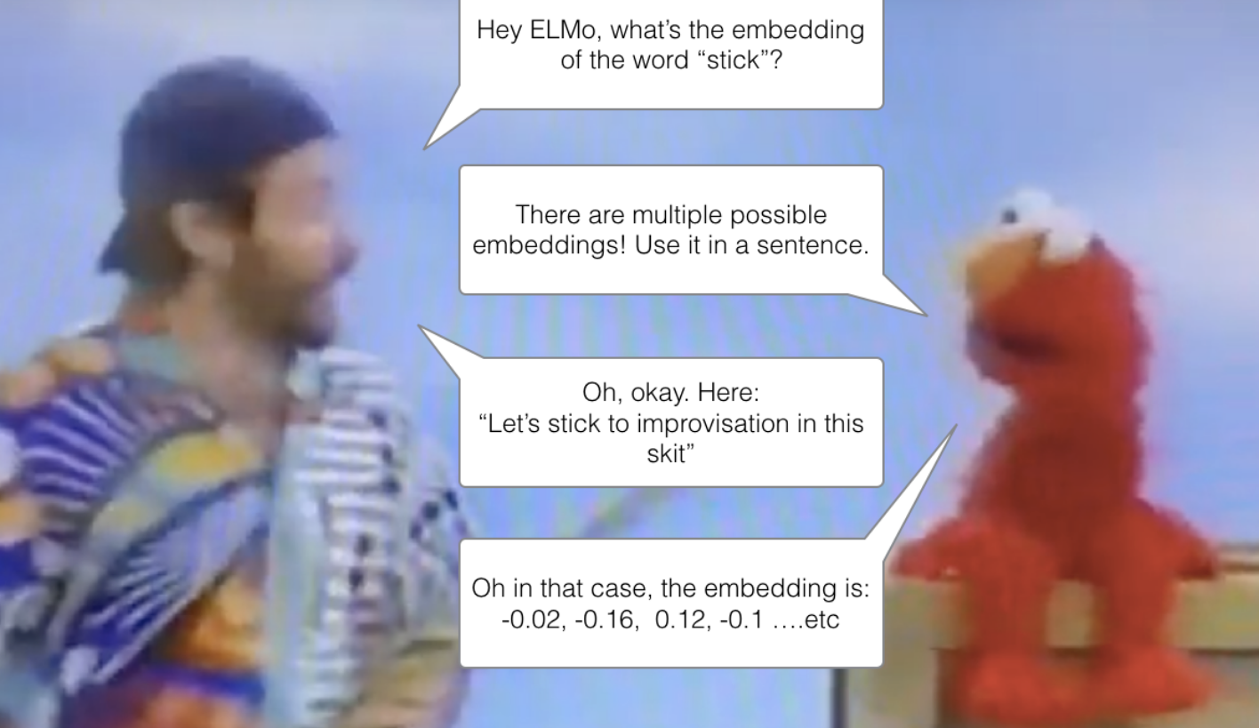
Context Encoding
Context2vec, ELMo were the start of the contextualized-word embeddings

Slide 39
ELMo
Instead of using a fixed embedding for each word, ELMo looks at the entire sentence before assigning each word in it an embedding
It uses bi-directional LSTM to create those embeddings
Trained to predict the next word in a sequence of words – another way of saying doing “language modeling”

Slide 40
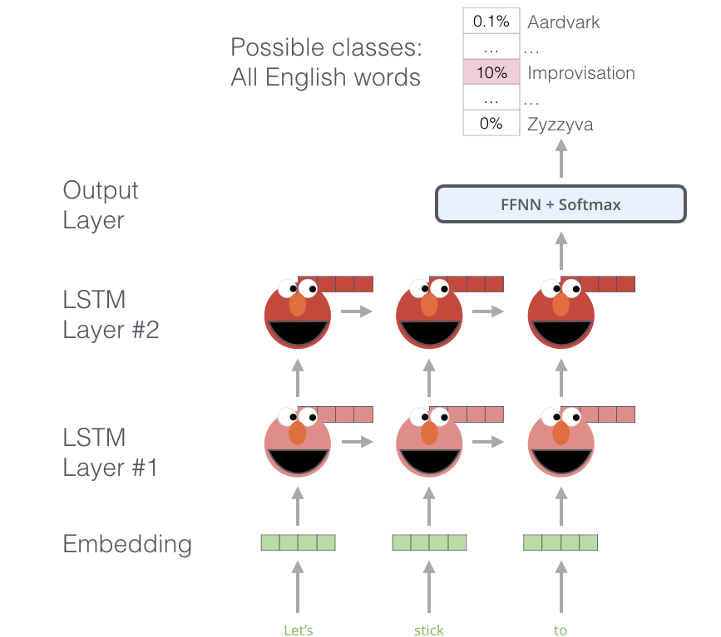
ELMo
Trained to predict the next word in a sequence of words – a.k.a. LM

Slide 41
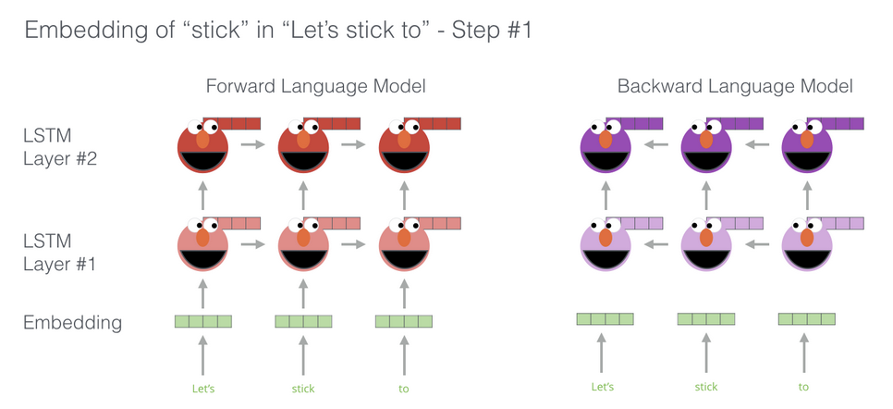
ELMo
Use bi-directional LSTM, so that the representation of a word is informed by its next and previous word

Slide 42
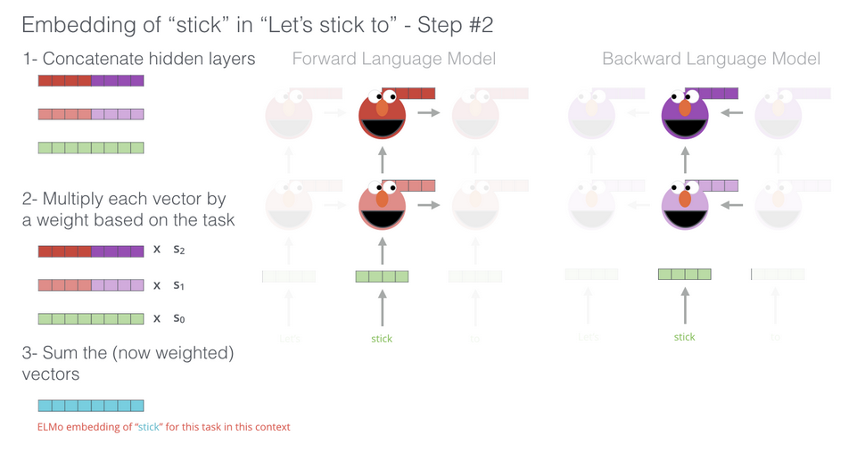
ELMo
Create a contextualized- embedding by grouping together the hidden states and initial embedding (concatenation followed by weighted summation)

Slide 43
BERT
Transformer-encoder model whose LM looks both forward and backward
Cannot be trained like other typical “predict the next word in the sequence” LM since transformer-encoder is multi layered and absorbs all parts of the input sentence at once
Using Masked LM

Slide 44
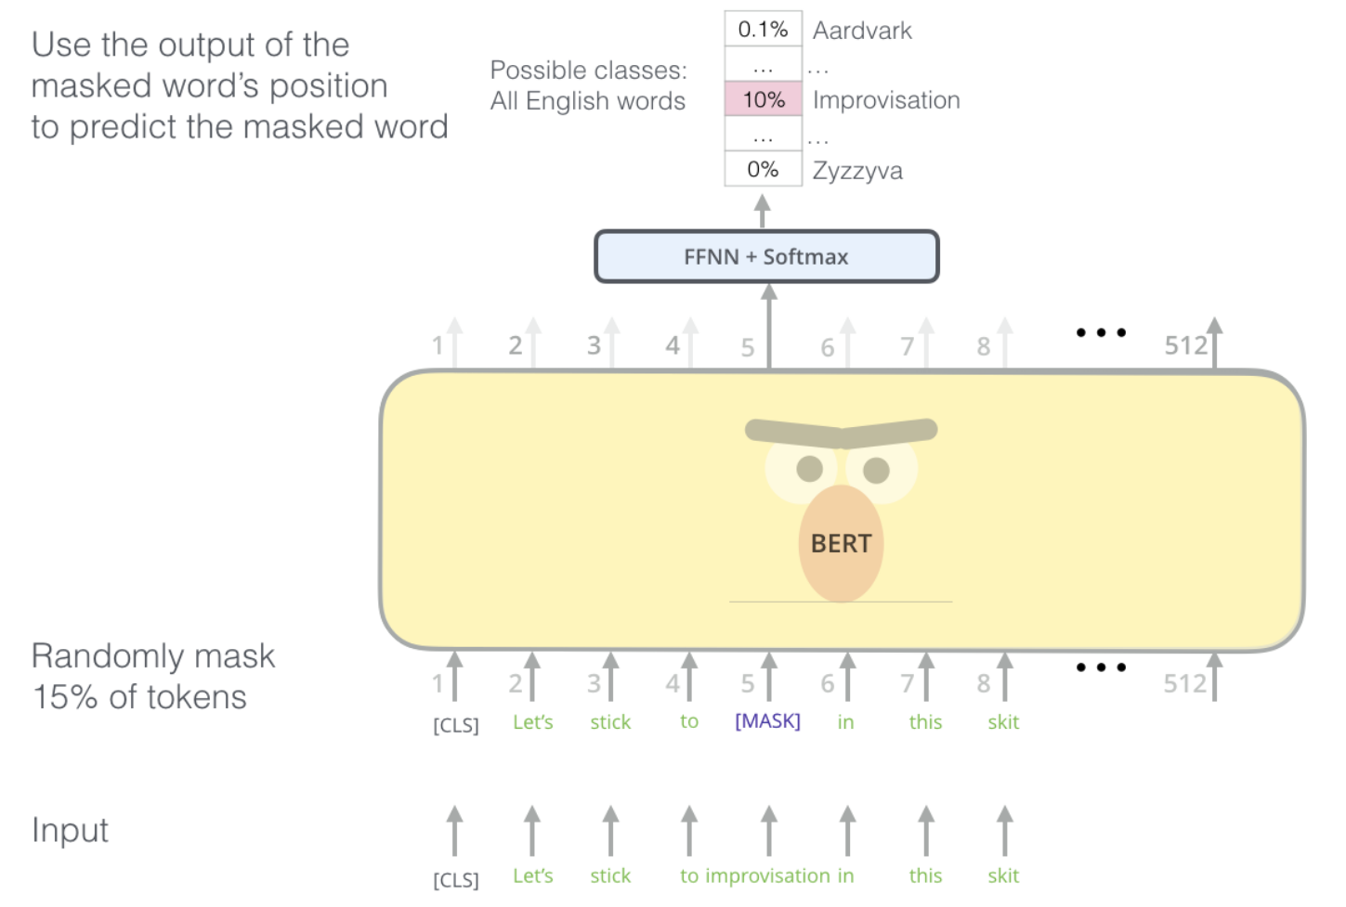
BERT
Masked LM also called a Cloze task
Also randomly replaces a word with another word and asks to predict the correct word

Slide 45
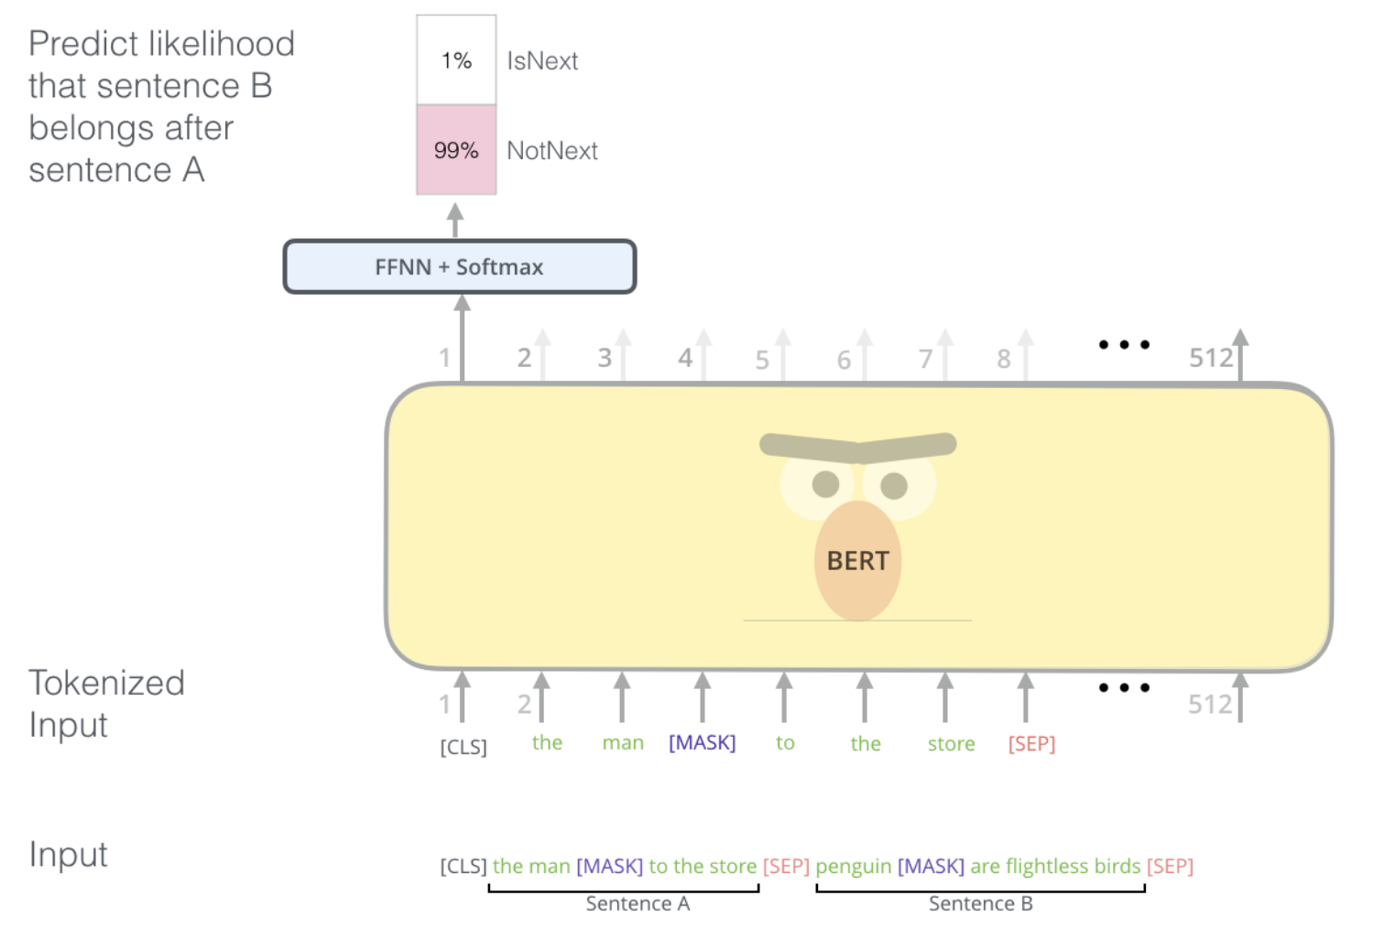
BERT
Also trained on multiple sentences

Slide 46
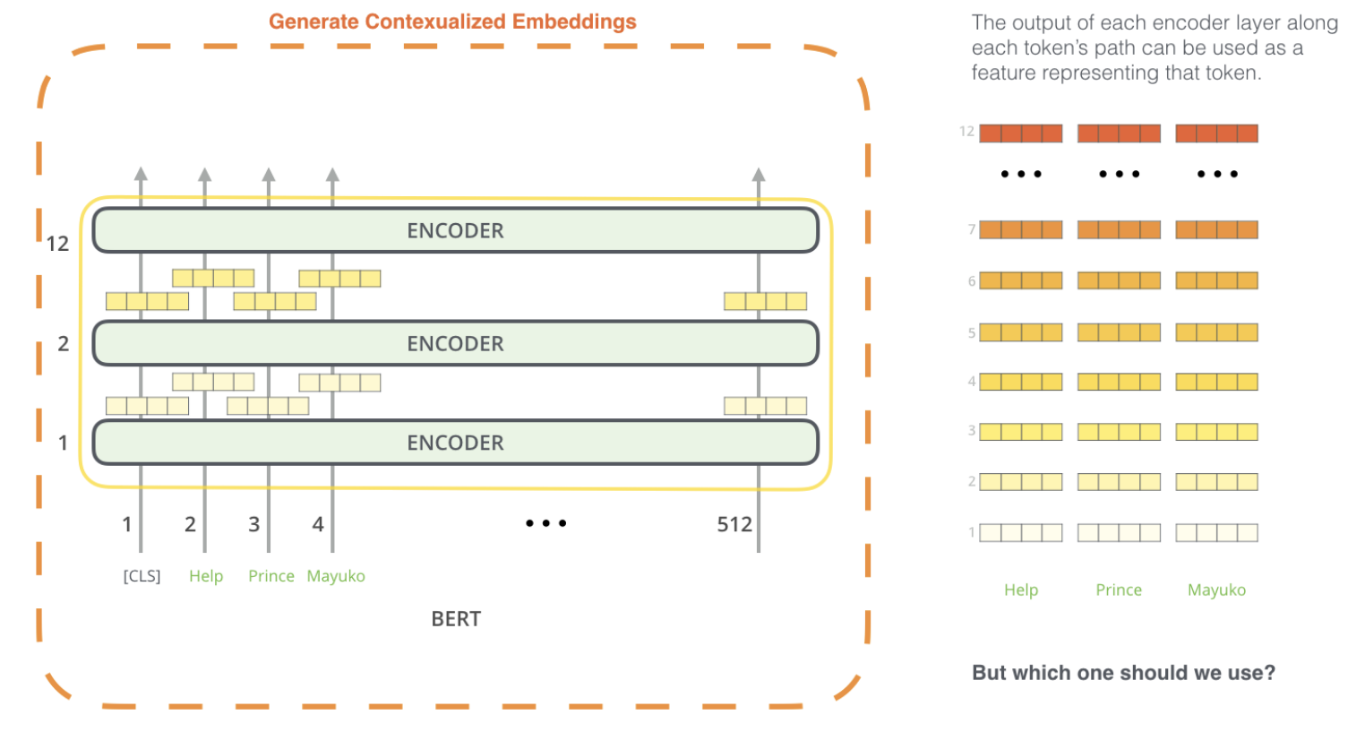
BERT
Can also be used to create embeddings (without fine tuning)

Slide 47
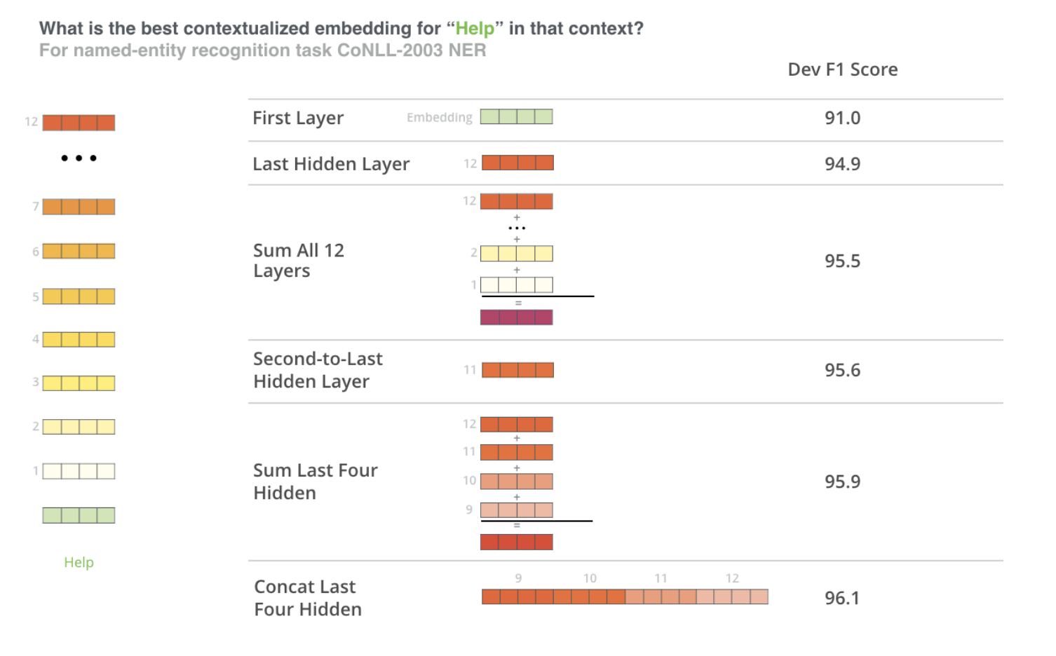
BERT
Can also be used to create embeddings (without fine tuning)

Slide 48
Try out BERT and other Transformers
https://github.com/google-research/bert
https://github.com/huggingface/transformers

Slide 49
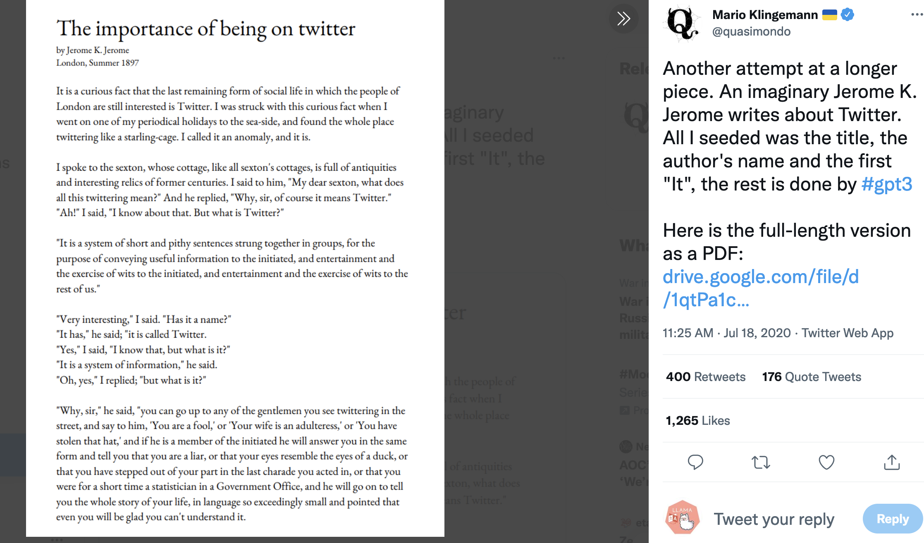
GPT Language Models

Slide 50
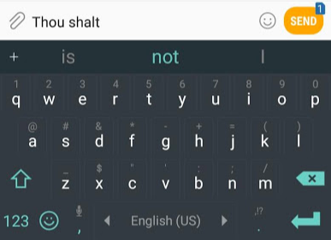
GPT Language Models
https://jalammar.github.io/illustrated-gpt2/
Language model that is able to look at part of a sentence and predict the next word
Autocomplete
Larger, more sophisticated
GPT-2 is trained on 40GB WebText
Takes 500MBs for storage (smallest) to 6.5GB (largest)

Slide 51
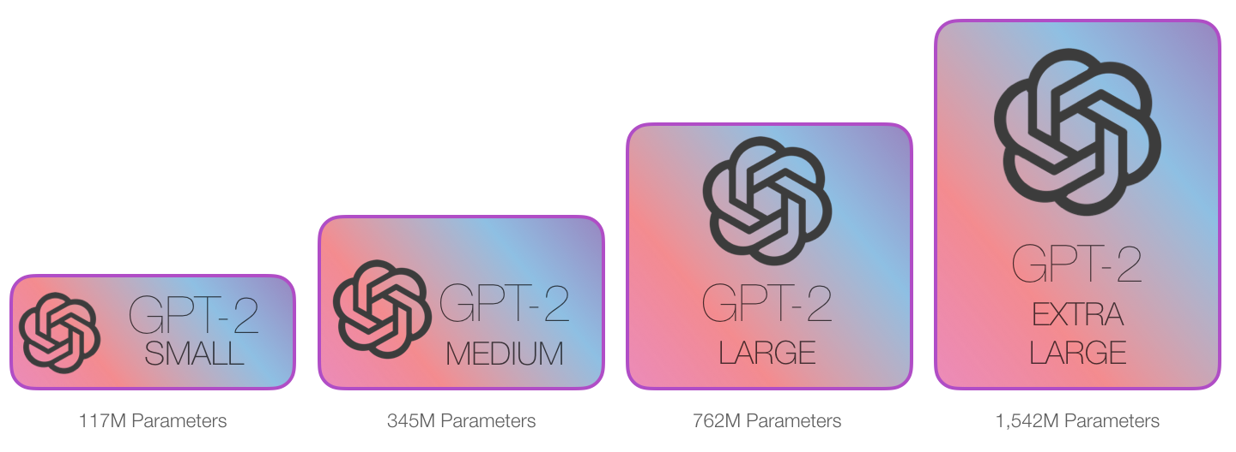
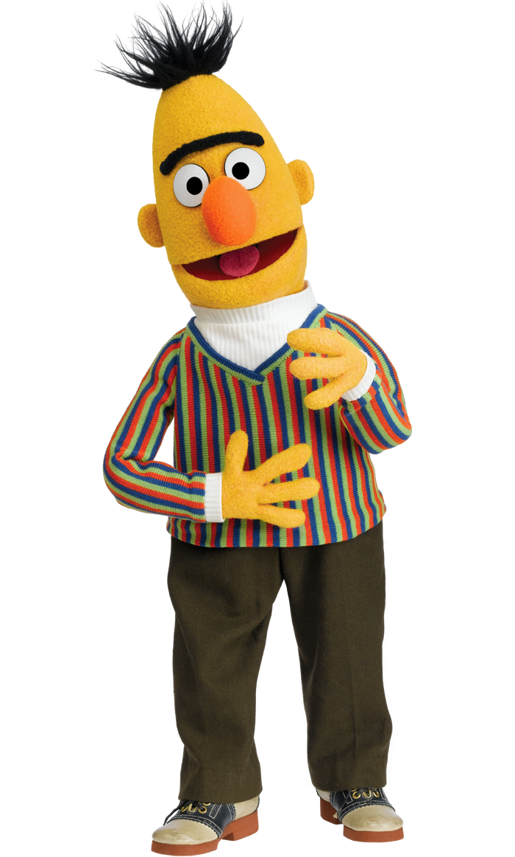


GPT Language Models
https://jalammar.github.io/illustrated-gpt2/
BERT 110M parameters

Slide 52
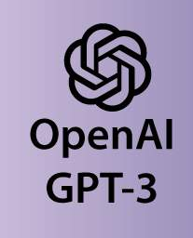
GPT Language Models
https://jalammar.github.io/illustrated-gpt2/
BERT 110M parameters
175B parameters

Slide 53
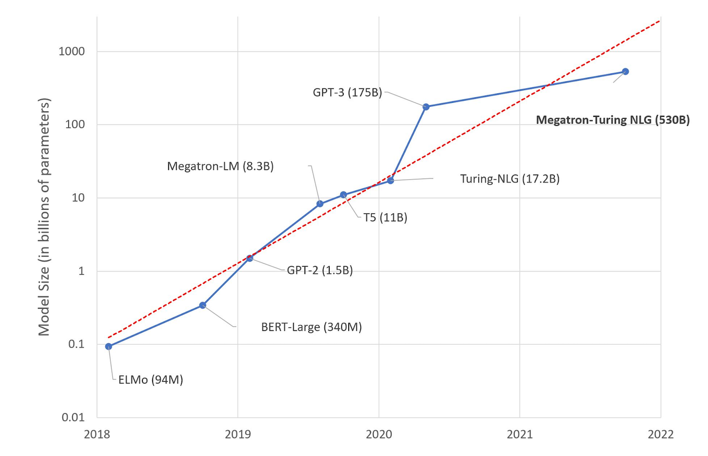
GPT Language Models
https://jalammar.github.io/illustrated-gpt2/
https://lastweekin.ai/p/gpt-3-is-no-longer-the-only-game?s=r

Slide 54
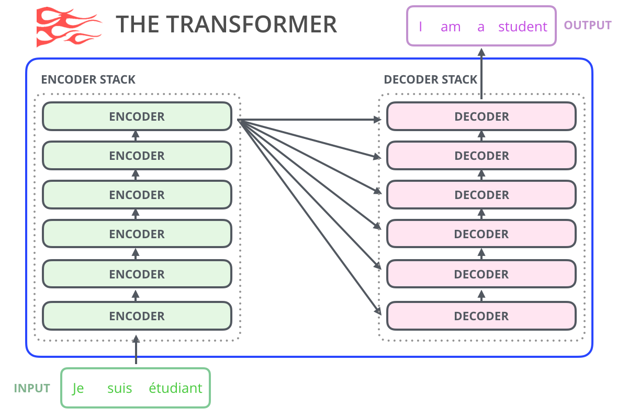
GPT Language Models
https://jalammar.github.io/illustrated-gpt2/
Notes:
the original transformer model is made up of an encoder and decoder – each is a stack of what we can call transformer blocks. That architecture was appropriate because the model tackled machine translation – a problem where encoder-decoder architectures have been successful in the past.

Slide 55
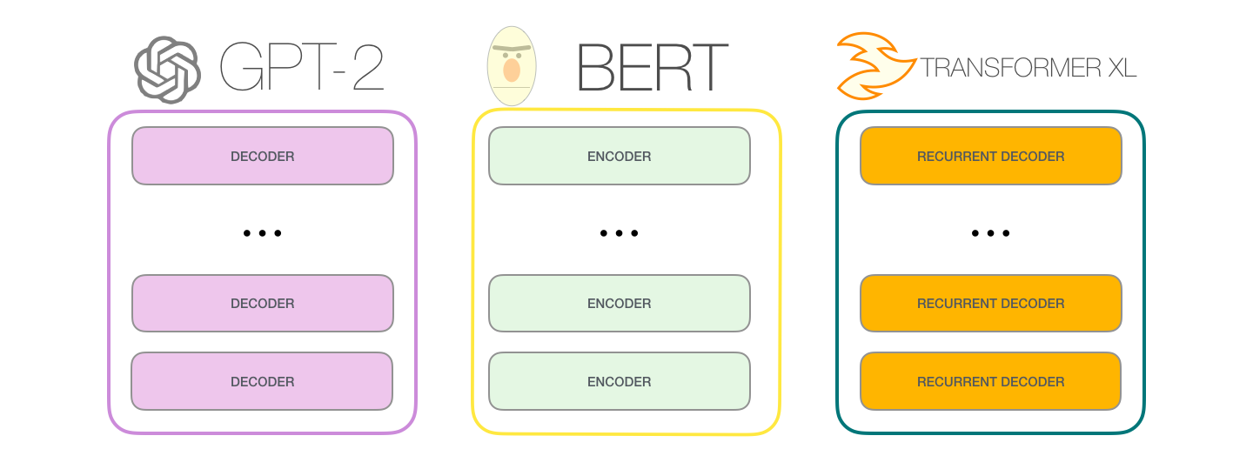
GPT Language Models
https://jalammar.github.io/illustrated-gpt2/
Notes:
A lot of the subsequent research work saw the architecture shed either the encoder or decoder, and use just one stack of transformer blocks – stacking them up as high as practically possible, feeding them massive amounts of training text, and throwing vast amounts of compute at them

Slide 56
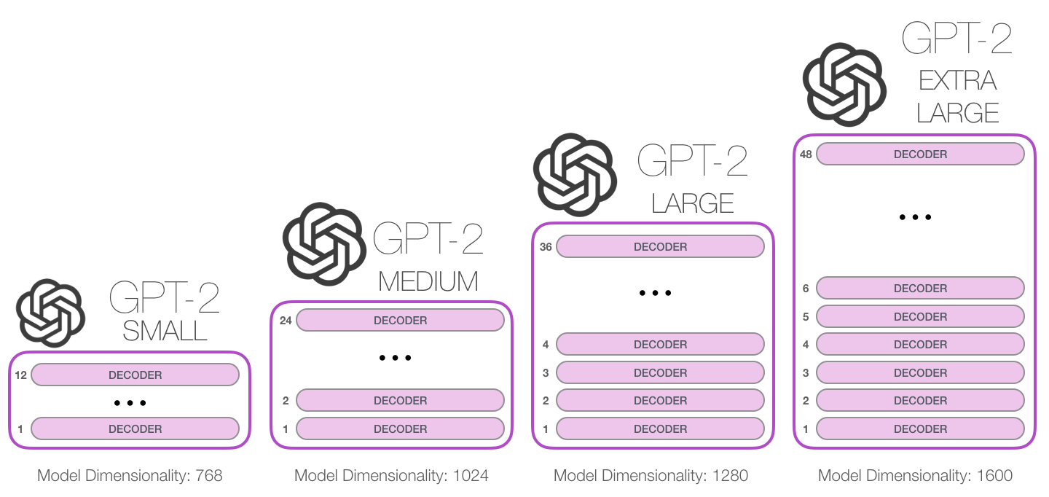
GPT Language Models
https://jalammar.github.io/illustrated-gpt2/
Notes:
How high can we stack up these blocks? It turns out that’s one of the main distinguishing factors between the different GPT2 model sizes:

Slide 57
GPT Language Models
https://jalammar.github.io/illustrated-gpt2/
Only using transformer decoder blocks (BERT is using transformer encoder blocks)
Outputs one token at a time:
“autoregression”: after each token is produced, that token is added to the sequence of inputs, and that new sequence becomes the input to the model in its next step

Slide 58
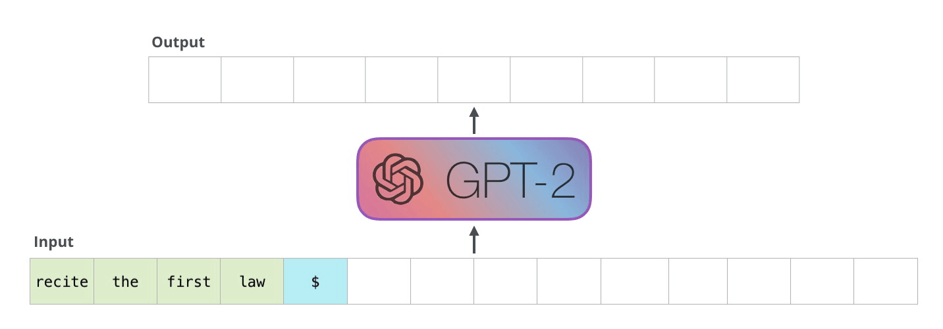
GPT Language Models
https://jalammar.github.io/illustrated-gpt2/

Slide 59
GPT Language Models
https://jalammar.github.io/illustrated-gpt2/
Only using transformer decoder blocks (BERT is using transformer encoder blocks)
Outputs one token at a time:
“autoregression”: after each token is produced, that token is added to the sequence of inputs, and that new sequence becomes the input to the model in its next step
Self-attention layer masks future tokens
Notes:
One key difference in the self-attention layer here, is that it masks future tokens – not by changing the word to [mask] like BERT, but by interfering in the self-attention calculation blocking information from tokens that are to the right of the position being calculated.

Slide 60


GPT Language Models
https://jalammar.github.io/illustrated-gpt2/

Slide 61

GPT Language Models
https://jalammar.github.io/illustrated-gpt2/
Notes:
The simplest way to run a trained GPT-2 is to allow it to ramble on its own (which is technically called generating unconditional samples) – alternatively, we can give it a prompt to have it speak about a certain topic (a.k.a generating interactive conditional samples). In the rambling case, we can simply hand it the start token and have it start generating words.
The model only has one input token, so that path would be the only active one. The token is processed successively through all the layers, then a vector is produced along that path. That vector can be scored against the model’s vocabulary (all the words the model knows, 50,000 words in the case of GPT-2). In this case we selected the token with the highest probability, ‘the’. But we can certainly mix things up – you know how if you keep clicking the suggested word in your keyboard app, it sometimes can stuck in repetitive loops where the only way out is if you click the second or third suggested word. The same can happen here. GPT-2 has a parameter called top-k that we can use to have the model consider sampling words other than the top word (which is the case when top-k = 1).

Slide 62

GPT Language Models
https://jalammar.github.io/illustrated-gpt2/
Notes:
In the next step, we add the output from the first step to our input sequence, and have the model make its next prediction
Notice that the second path is the only that’s active in this calculation. Each layer of GPT-2 has retained its own interpretation of the first token and will use it in processing the second token
GPT-2 does not re-interpret the first token in light of the second token.

Slide 63


GPT Language Models – Inner Workings
https://jalammar.github.io/illustrated-gpt2/
Inputs:
Notes:
Let’s start from the input. As in other NLP models we’ve discussed before, the model looks up the embedding of the input word in its embedding matrix – one of the components we get as part of a trained model.
Before handing that to the first block in the model, we need to incorporate positional encoding – a signal that indicates the order of the words in the sequence to the transformer blocks. Part of the trained model is a matrix that contains a positional encoding vector for each of the 1024 positions in the input.

Slide 64

GPT Language Models – Inner Workings
https://jalammar.github.io/illustrated-gpt2/
Inputs:
Notes:
Sending a word to the first transformer block means looking up its embedding and adding up the positional encoding vector for position #1.

Slide 65

GPT Language Models – Inner Workings
https://jalammar.github.io/illustrated-gpt2/
Up the stack:
Notes:
The first block can now process the token by first passing it through the self-attention process, then passing it through its neural network layer. Once the first transformer block processes the token, it sends its resulting vector up the stack to be processed by the next block. The process is identical in each block, but each block has its own weights in both self-attention and the neural network sublayers.

Slide 66

GPT Language Models – Inner Workings
https://jalammar.github.io/illustrated-gpt2/
Self-attention:
Process words by incorporating the context they are referring to in the sentence
By assigning scores to how relevant each word in the sentence is and adding up their vector representation
it refers to the robot
such orders refers to the earlier part of the law, namely “the orders given it by human beings”
The First Law refers to the entire First Law

Slide 67



GPT Language Models – Inner Workings
https://jalammar.github.io/illustrated-gpt2/
Self-attention:
Notes:
As an example, this self-attention layer in the top block is paying attention to “a robot” when it processes the word “it”. The vector it will pass to its neural network is a sum of the vectors for each of the three words multiplied by their scores.
This weighted blend of value vectors results in a vector that paid 50% of its “attention” to the word robot, 30% to the word a, and 19% to the word it.

Slide 68

GPT Language Models – Inner Workings
https://jalammar.github.io/illustrated-gpt2/
Output:
Notes:
We can simply select the token with the highest score (top_k = 1). But better results are achieved if the model considers other words as well. So a better strategy is to sample a word from the entire list using the score as the probability of selecting that word (so words with a higher score have a higher chance of being selected).
With that, the model has completed an iteration resulting in outputting a single word. The model continues iterating until the entire context is generated (1024 tokens) or until an end-of-sequence token is produced.

Slide 69

GPT Language Models – Going Deeper on Masked Self Attention
https://jalammar.github.io/illustrated-gpt2/

Slide 70

GPT Language Models – Going Deeper on Masked Self Attention
https://jalammar.github.io/illustrated-gpt2/

Slide 71

GPT Language Models – Going Deeper on Masked Self Attention
https://jalammar.github.io/illustrated-gpt2/

Slide 72

GPT Language Models – Going Deeper on Masked Self Attention
https://jalammar.github.io/illustrated-gpt2/

Slide 73

GPT Language Models – Going Deeper on Masked Self Attention
https://jalammar.github.io/illustrated-gpt2/

Slide 74

GPT Language Models – Going Deeper on Masked Self Attention
During training: Batch processing of pairs of input and output
https://jalammar.github.io/illustrated-gpt2/
Notes:
Think of a sequence of four words (“robot must obey orders”, for example). In a language modeling scenario, this sequence is absorbed in four steps – one per word (assuming for now that every word is a token). As these models work in batches, we can assume a batch size of 4 for this toy model that will process the entire sequence (with its four steps) as one batch.

Slide 75



GPT Language Models – Going Deeper on Masked Self Attention
During training: compute self attention scores
1
2
3
https://jalammar.github.io/illustrated-gpt2/
Notes:
After the multiplication, we slap on our attention mask triangle. It set the cells we want to mask to -infinity or a very large negative number (e.g. -1 billion in GPT2)
Then, applying softmax on each row produces the actual scores we use for self-attention
What this scores table means is the following:
When the model processes the first example in the dataset (row #1), which contains only one word (“robot”), 100% of its attention will be on that word.
When the model processes the second example in the dataset (row #2), which contains the words (“robot must”), when it processes the word “must”, 48% of its attention will be on “robot”, and 52% of its attention will be on “must”.
And so on

Slide 76

GPT Language Models – Going Deeper on Masked Self Attention
During evaluation:
https://jalammar.github.io/illustrated-gpt2/
Notes:
GPT-2 holds on to the key and value vectors of the the “a” token. Every self-attention layer holds on to its respective key and value vectors for that token

Slide 77

GPT Language Models – Going Deeper on Masked Self Attention
During evaluation:
https://jalammar.github.io/illustrated-gpt2/
Notes:
GPT-2 holds on to the key and value vectors of the the “a” token. Every self-attention layer holds on to its respective key and value vectors for that token.
Now in the next iteration, when the model processes the word robot, it does not need to generate query, key, and value queries for the “a” token. It just reuses the ones it saved from the first iteration:

Slide 78

GPT Language Models – Going Deeper on Masked Self Attention
Implementation: input (token embedding + positional embedding)
https://jalammar.github.io/illustrated-gpt2/

Slide 79

GPT Language Models – Going Deeper on Masked Self Attention
Implementation: create query, key, value vectors
https://jalammar.github.io/illustrated-gpt2/

Slide 80

GPT Language Models – Going Deeper on Masked Self Attention
Implementation: create query, key, value vectors for multiple attention heads
https://jalammar.github.io/illustrated-gpt2/

Slide 81

GPT Language Models – Going Deeper on Masked Self Attention
Implementation: create query, key, value vectors for multiple attention heads
https://jalammar.github.io/illustrated-gpt2/

Slide 82

GPT Language Models – Going Deeper on Masked Self Attention
Implementation: within each attention head, compute attention scores
https://jalammar.github.io/illustrated-gpt2/

Slide 83

GPT Language Models – Going Deeper on Masked Self Attention
Implementation: within each attention head, compute attention scores
https://jalammar.github.io/illustrated-gpt2/

Slide 84

GPT Language Models – Going Deeper on Masked Self Attention
Implementation: within each attention head, compute attention scores, and create a weighted sum of value vectors
https://jalammar.github.io/illustrated-gpt2/

Slide 85

GPT Language Models – Going Deeper on Masked Self Attention
Implementation: merge vectors from multiple heads
https://jalammar.github.io/illustrated-gpt2/

Slide 86

GPT Language Models – Going Deeper on Masked Self Attention
Implementation: project the vectors and pass to the FFNN
https://jalammar.github.io/illustrated-gpt2/
Notes:
We’ll let the model learn how to best map concatenated self-attention results into a vector that the feed-forward neural network can deal with. The weight matrix projects the results of the attention heads into the output vector of the self-attention sublayer

Slide 87

GPT Language Models – Going Deeper on Masked Self Attention
Implementation: FFNN layer 1
https://jalammar.github.io/illustrated-gpt2/
Notes:
The fully-connected neural network is where the block processes its input token after self-attention has included the appropriate context in its representation. It is made up of two layers. The first layer is four times the size of the model (Since GPT2 small is 768, this network would have 768*4 = 3072 units). Why four times? That’s just the size the original transformer rolled with (model dimension was 512 and layer #1 in that model was 2048). This seems to give transformer models enough representational capacity to handle the tasks that have been thrown at them so far.

Slide 88

GPT Language Models – Going Deeper on Masked Self Attention
Implementation: FFNN layer 2
https://jalammar.github.io/illustrated-gpt2/

Slide 89

GPT Language Models – Going Deeper on Masked Self Attention
Implementation Recap
https://jalammar.github.io/illustrated-gpt2/

Slide 90

GPT Language Models – Going Deeper on Masked Self Attention
Implementation Recap
https://jalammar.github.io/illustrated-gpt2/

Slide 91

GPT Language Models – Application
Machine translation (decoder only)

Slide 92

GPT Language Models – Application
Summarization
Notes:
This is the task that the first decoder-only transformer was trained on. Namely, it was trained to read a wikipedia article (without the opening section before the table of contents), and to summarize it. The actual opening sections of the articles were used as the labels in the training datasest:

Slide 93

GPT Language Models – Application
Summarization
Notes:
This is the task that the first decoder-only transformer was trained on. Namely, it was trained to read a wikipedia article (without the opening section before the table of contents), and to summarize it. The actual opening sections of the articles were used as the labels in the training datasest:

Slide 94


GPT Language Models – Application
Music Transformer: https://magenta.tensorflow.org/music-transformer
Notes:
This is the task that the first decoder-only transformer was trained on. Namely, it was trained to read a wikipedia article (without the opening section before the table of contents), and to summarize it. The actual opening sections of the articles were used as the labels in the training datasest:

Slide 95
Try out GPTs
GPT2: Decoder only transformer http://jalammar.github.io/illustrated-gpt2/
Try out GPT3 yourself: https://beta.openai.com/playground/ (requires signing up)

